Slide 1
Microfluidic systems: tools for life science and environment
ALIVE Strategic Axis
Pierre Joseph

Slide 2
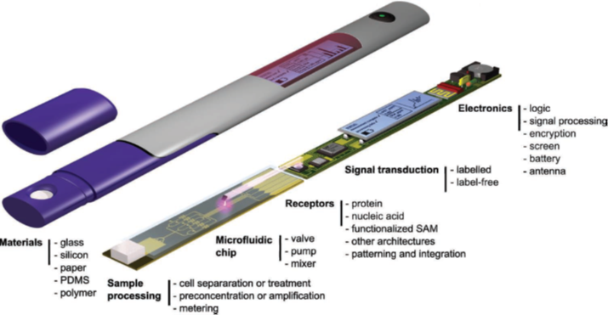
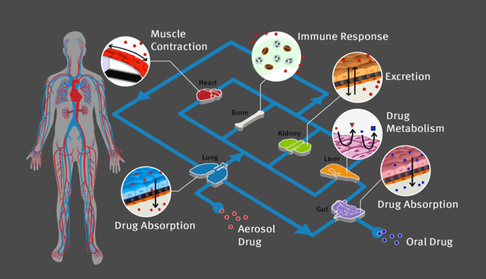
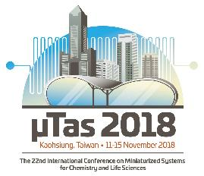
Context: the microfluidic toolbox
Manipulate fluids in engineered microchannels: what for?
Lab-on-chips
Model systems
Gervais, 2011
A. Kaushal 2016
Controlled Integrated microsystems to mimic microenvironment and study physiological response
Integrate fluid handling, sample prep, sensing
for reliable, //, cheap detection, diagnostics
Notes:
Microfluidics is the manipulation of fluid inside engineered microsystems. It is used, at LAAS and in many other institutes, for different purposes.
The first, most spread one, is the lab-on-chip concept: integrating in a single device fluid handling, sample prep, sensing, data analysis, communication is meant to obtain all the functions of a laboratory, with the adantages of reliability, high throughput (//), cheap detection, full diagnostics.
The second, that emerged more recently, uses the control of conditions, integrated on a chip, to mimic a microenvironment. It is the idea of model systems to decipher processes occuring in complex, real, situations.

Slide 3

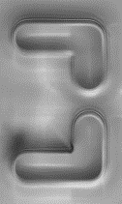

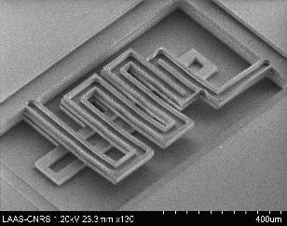
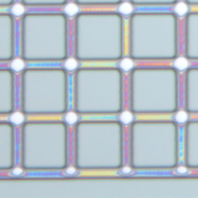
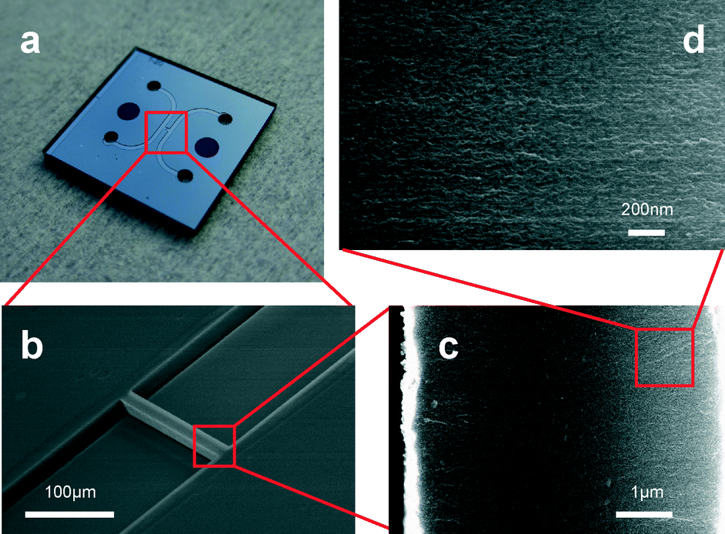
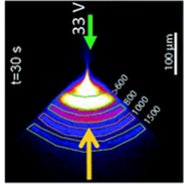
Fabrication Technologies
Standard Microchannels
2.5D, 3D, active elements
Si, Glass,
polymers
Nanochannels
25 µm
200 nm
Scale:
Molecular Cellular System
[nm] [µm] Models/sensing
Integrate Porous silicon membranes
Courson, RSC Advances 2014 Leichlé, Lab Chip 2015
Naillon, Micro Nanofluidics 2017 Raimbault, Flow 2017
Notes:
LAAS is an engineering lab and we benefit from an exceptional technological platform (part of National Renatech network), that you can visit tomorrow, to build all kinds of « standard » microchannels made of different materials.
We also drive technological development:
- for example at the nanoscale: we can fabricate nanoslit with typical depth 20 nm, and we have integrated porous silicon membranes in channels to build filters, to concentrate molecules.
- Another important axis of technological developments conerns the integration of complex topologies, such non-uniform depth nanochannels, lamination to build 3D devices, and active functions such as the in-channel pump you see on the video.
These developments enables us to develop microfluidics at different scales:
-first, we set up microfluidic functions at the molecular (or nm) scale,
- we develop fluidic functions at the cellular [µm] scale,
- at the system scale, two axes can be distinguished: first, the integration of fluidics with a full device (sensor); second, the idea of model systems

Slide 4
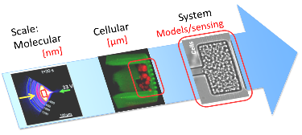


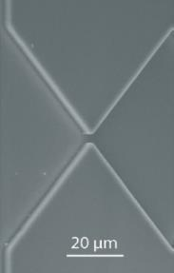
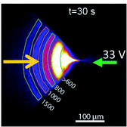
Molecular functions
Concentrate, purify, detect DNA, RNA
[nm]
Transverse forces in a visco-elastic fluid
→ DNA concentration/separation
Nanofluidic-Embedded Biosensors
→ miRNA Single-Nucleotide Difference Discrimination
ΔP
ΔV
Combine droplets and magnetic tweezers:
→RNA purification, reverse transcription, amplification
2 bar
100bp DNA ladder
Ranchon, Lab Chip 2016 Cacheux, ACS Sensors 2018
Ferraro, Sci Rep 2016
Notes:
Lets start at the molecular scale: we develop original principles and chips to achieve relevant fluidic functions, such as in this example the concentration (real time, a thousand times factor of concentration) of DNA.
Here the use of nanofluidic confinement to enhance the resolution and sensitivity of a surface sensor, to discriminate single nucleotide mutation of RNA.
In this last approach, we combine a droplets platform with magnetic particles to perform all steps needed in RNA sample preparation.

Slide 5
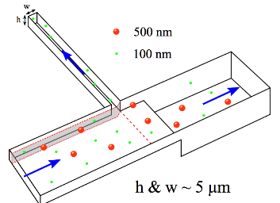
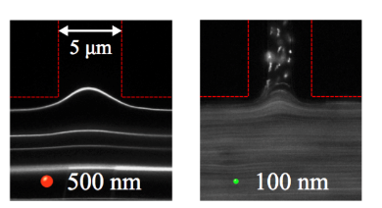
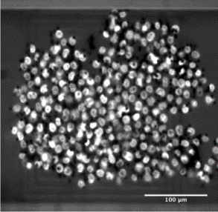
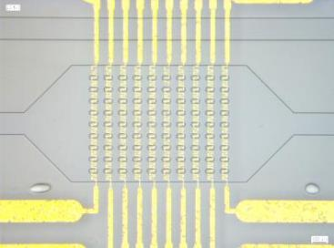
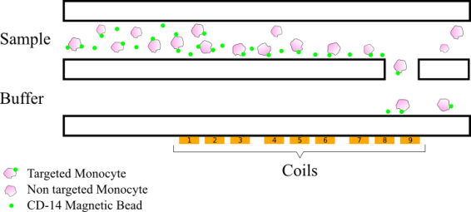
Single object functions
[µm]
Sort (or capture) colloids and cells
Hydrodynamic filtration → Sort colloids
Physical capture →Trap Circulating Tumor Cells
Magnetic particles & Integrated coils → Trap/sort cells
Fouet, Lab Chip 2016
Manczac, Sensors Actuators 2016
Cerf, Patent 2016
Notes:
Going up the scale, we also develop single objects, µm scale, functions, such as (for environmental sensors), this simple geometry enabling to sort out colloid with a given size or order 200 nm.
Physical capture has been used to trap circulating tumor cells in the blood.
Coils in multilevel channels, combined with antibody labeling, has been used to trap specific cells

Slide 6
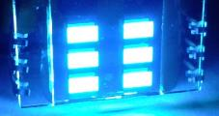
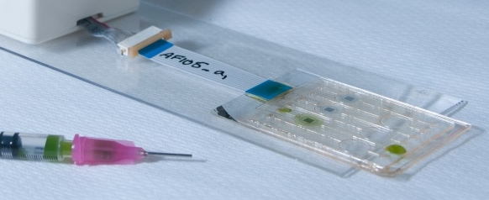
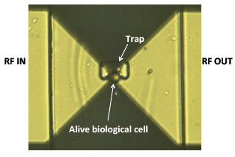

Fluid handling in sensing
[System]
Algae as an environmental sensor
Integrate electrochemical sensing, fluidics, optics
Algae metabolism is sensitive to pollutants
→ Sense contaminants
RF response of biological elements
Combining single human cell trapping with microwave dielectric spectroscopy → Monitoring of therapeutic impact
)))
)))
Tsopela, Biosensors 2016
T. Chen et al, IEEE IMS 2013
A. Tamra et al, IEEE TMTT 2017
Notes:
Going to the system scale, the first aspect I want to mention is the integration of fluidics in a sensing device.
Here, for example, an algae is injected in a channel integrating both optical and electrochemical detection, to sense water pollutants (the algae metabolism is sensitive to contaminants).
In this second case, the function of trapping a single human cell is combined with RF microwave dielectric spectroscopy, to monitor the effects of drugs.

Slide 7
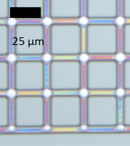
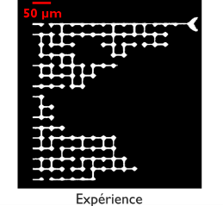
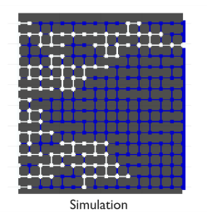
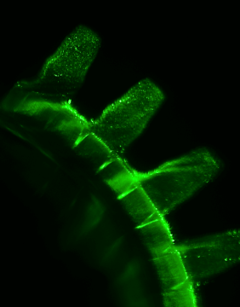
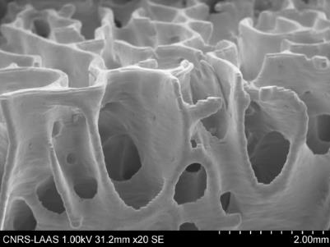
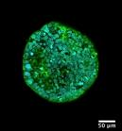
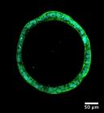
Model systems
[System]
Microphysiological systems
Model porous media
Cell growth under pressure
Feeding, measuring & controlling P
Invasion pattern of a 2D nanoporous medium, model of a geological reservoir
Cell growth in 3D microenvironments
Control topology, rigidity, + perfusion
3D printed bone scaffold
200 µm
Naillon, Phys Rev Lett 2018 Delarue, Nature Physics 2016
Mézières, JASA 2016
Notes:
The second concept we develop at the system scale is this idea of model systems.
Let me take for environment the example of infiltration of water, or of sequestration of CO2, in natural soils. Analysing all processes occuring in the real system is really challenging, and we can gain relevant information by working on artificial, fabricated microdevices (here network of 2.5D nanochannels) simplifying the situation to capture the main mechanisms.
For life science, we are building microphysiological devices in which we can for example characterize how pressure and chemical constraints couple to influence the growth of a cell assembly. As perspective, for 3D printing and bioprinting –(that Laurent will describe in a moment), integrating microfluidic perfusion (feeding !) is important.

Slide 8
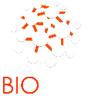

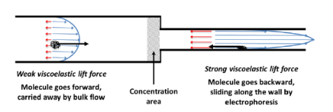
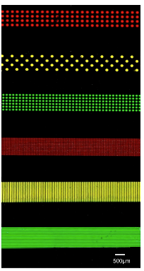

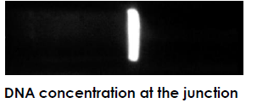
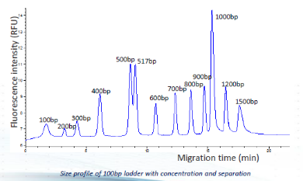
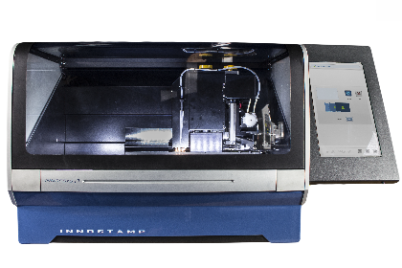
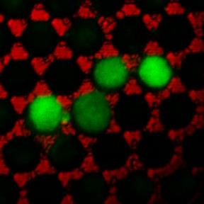

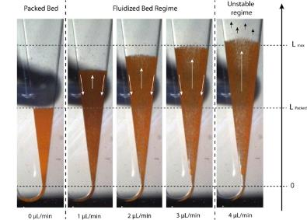

Transfers: Start-ups, industry
Transfer to SME
Mixed public/private Lab
Multiplexed microcontact printing with reversible clamping
Concentrate/separate DNA
In a capillary format
Start-ups
Automated sample preparation and analysis (droplet handling and fluidized bed)
3D microfilter:
trap CTCs
Notes:
The last message is the idea that, being an engineering lab, we are focused on basic science and knowledge but also work at transferring our research to society and companies:
For example, the DNA concentration technologies has been adapted to a format compatible with electrophoresis industrial standard , in collab with picometrics.
Biosoft is a mixed CNRS-Innopsys unit working at integrating new concepts in microcontact printing
2 start-ups have emerged from our activities on CTC trapping (Smart-Catch) and integrated sample preparation (Inorevia)

Slide 9
Microfluidics @ ALIVE
Microfluidic technologies for life & environment:
lab-on-chip & model systems
→ knowledge building & integrated sensing
At LAAS-CNRS, we benefit from technological (clean room) and experimental platforms (microscopy, cell culture, characterization)
Engineering research, towards transfer
Scale:
Molecular Cellular System
[nm] [µm] Models/sensing
Notes:
Take home message : Thanks to high-level platforms, we combine our effort to develop µfludics devices.
µflu : functions, for lab-on-chips, model systems and integrated sensing.
Research from fundamentals to transfers

