Slide 1
Sensing and interactions developments for life sciences and environmental applications
ALIVE Strategic Axis

Slide 2
Context
Biology, Medicine
Environment
Domains, which are large applicants and consumers of sensors and actuators
Need of detecting, analysing and/or quantifying multiple analytes, multiple events or changes
Notes:
Biology, medicine and environment are applicative domains, which….

Slide 3
Applicative domains repartition at LAAS
among researchers dealing with sensing and interactions
Quality of :
    Air
    Water
    Food
    Soil
Impact of potential pollutants :
    Heavy metals
    Volatile Organic Compounds
    Nanoparticles
    Pesticides
    Electromagnetic waves
    …
Precision agriculture; agronomy
Diagnostic
Prognostic
Therapeutic monitoring
Ubiquitous healthcare
Cellular and molecular mechanisms comprehension
BioMedical
Environment
51 researchers (77%)
15 researchers (23%)
Notes:
On this chart, you can see the applicative domains repartition at LAAS among researchers dealing with sensing and interactions. The biomedical one involves around 50 researchers at least, which corresponds to 3 quarters of ALIVE researchers working in this area. The main related investigations deal with diagnostic and prognostic of diseases, therapeutic monitoring, ubiquitous healthcare and for fundamental aspects toward further comprehension of cellular and molecular mechanisms.
ON the other side, the environment domain involves roughly 15 researchers, the other quarter of this chart. And corresponding investigations are dealing with the quality of …

Slide 4
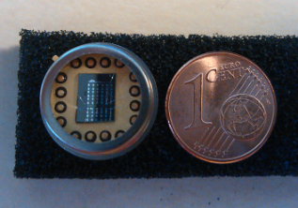
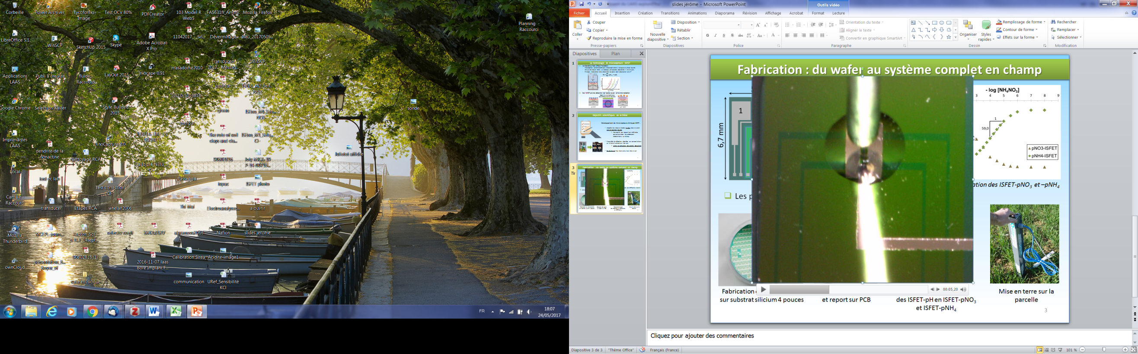
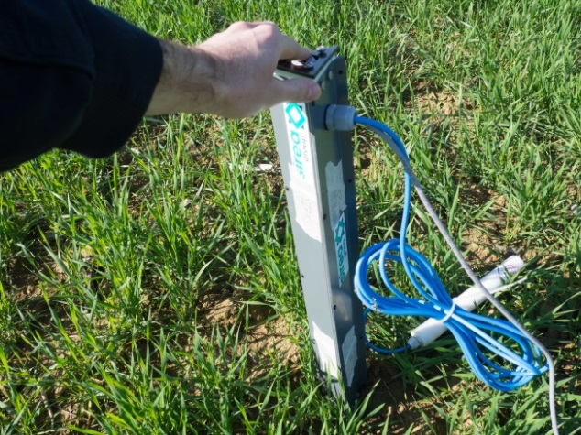
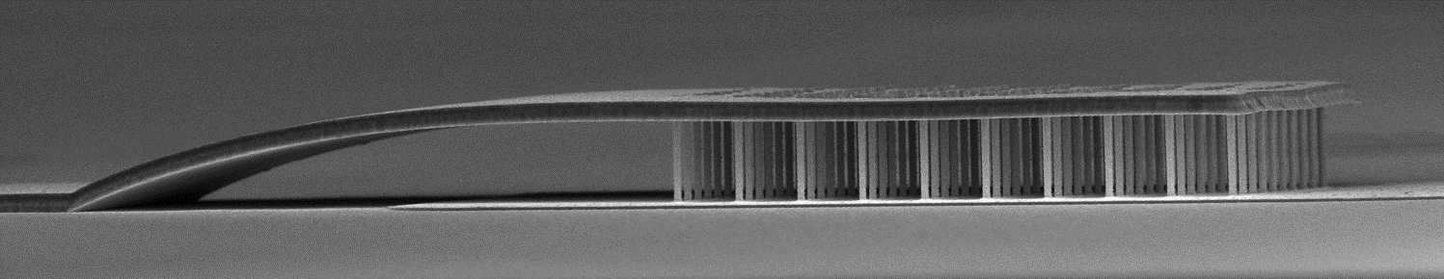
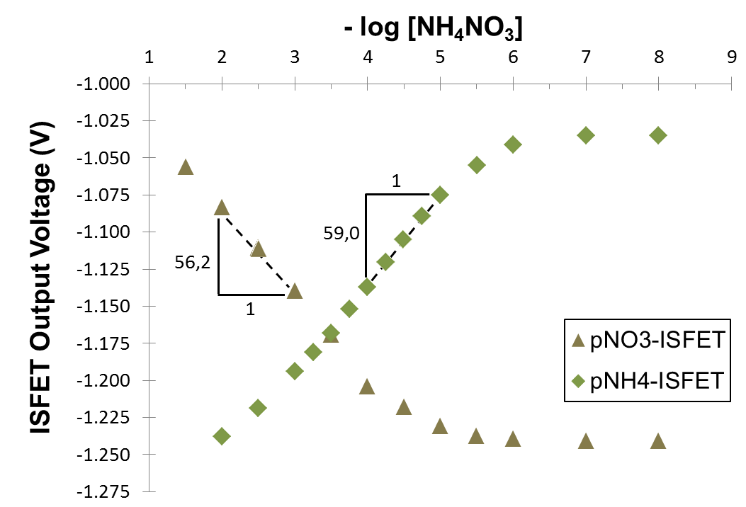
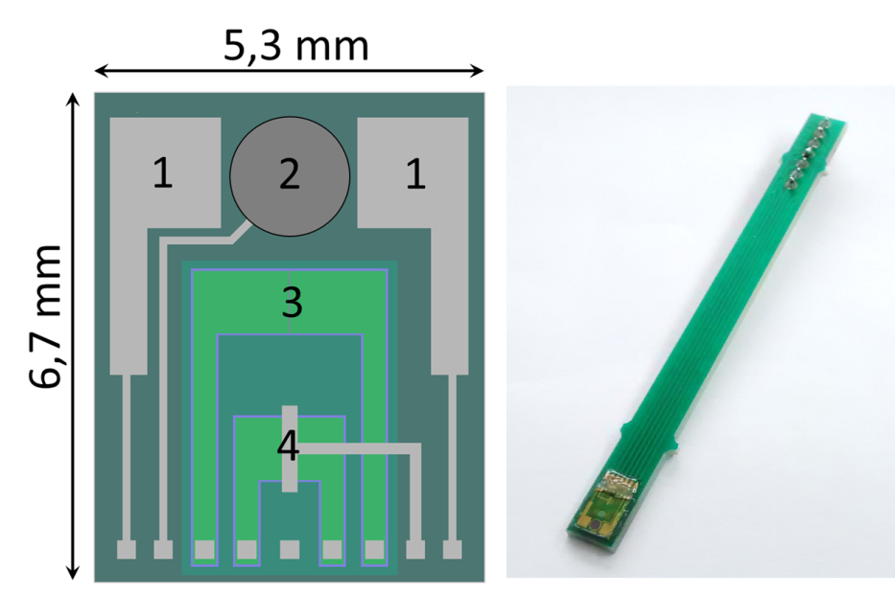
Environment sensing
Gas sensing :
Selective gas detection with nanowires sensors
Soil sensing :
Electrochemical sensors for agroindustries
Ground
I
V
Resistor configuration
Or Impedance vs freq
Functionalisation
ISFET-pH - ISFET-pNO₃ -ISFET-pNH₄
Embedded system in real conditions
50 ppb
70 ppb
90 ppb
1 : Platinum electrodes (conductivity and humidity)
2: Reference Electrode
3: ISFET-pH/pNO₃⁻/pNH₄⁺
4: MOSFET for temperature sensor
B. Durand et al. IEEE-NMDC.2016
Calibration data of ISFET-pNO₃ and –pNH₄
Notes:
1rst ex : Gas particles quantification with Resistance measurement after selective attachment of these particles on the nanowires
2nd ex : electrochemical sensor based on an ISFET technology to characterize nitrate concentrations in soils for agriculture industries.
Both sensors have been realized in the LAAS clean room facility, involving both nano and microfabrication processes.

Slide 5
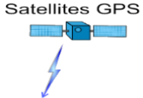
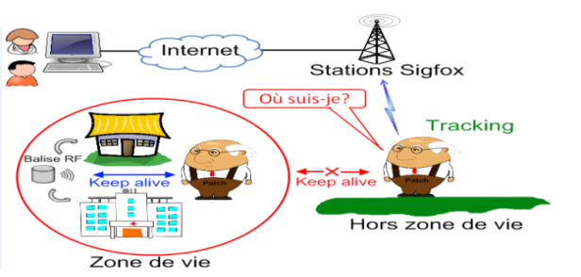
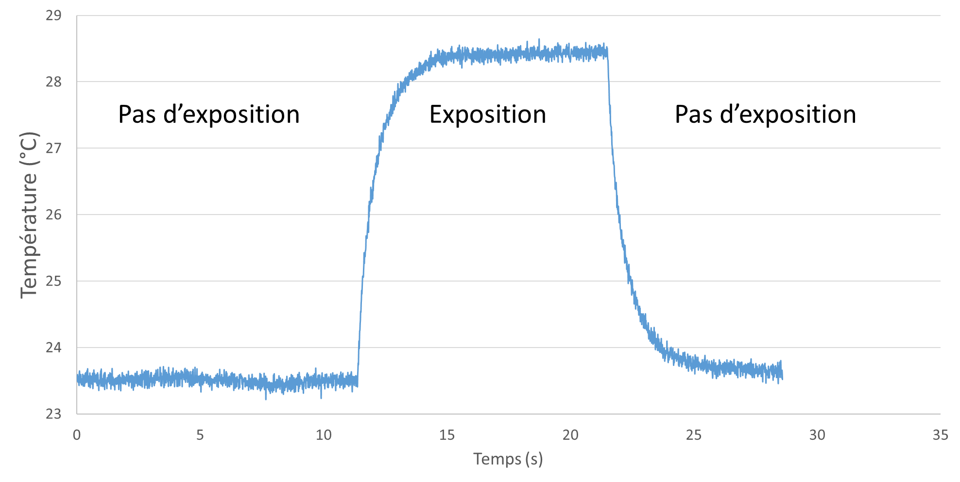
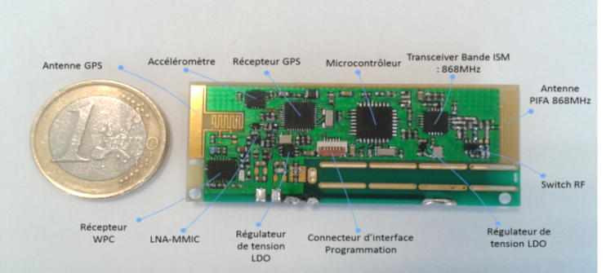
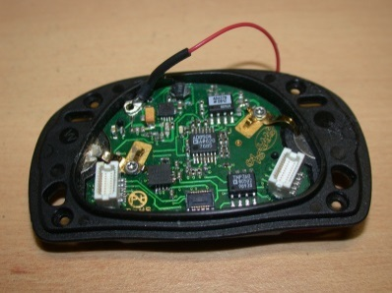
Environment impact on the living
Electromagnetic waves interaction
with the living
Realization of smart wireless electronic patches
for fragile population monitoring
)))
Microdosimetry
Controled SAR
Radiated microtissue
No exposure
Exposure
No exposure
Indoor-outdoor continuous monitoring (fall detection and localization)
Followed by traditional biological analysis : genotoxicity, membrane permeabilization evaluation
Stress detection module
Multi function hybrid integration
Correlation of cardiac and physic activity
Notes:
Another example is about the electromagnetic waves interaction with the living. It is indeed important to evaluate and quantify the impact of surrounding waves on cells, as we have with WIFI, Bluetooth… and new standards under development at higher frequencies. To perform such evaluation, the development of radiofrequency applicators for microdosimetry and controlled SAR - Specific Absorption Rate, are requested and you see here an example of one.
If interaction is characterized as nocive, then new EM waves constraints should be taken with modified standards; whereas it may also find therapeutic applications, as it is done for instance with electroporation to enable an easier access of therapeutic agents or genes or inversely to kill unwanted cells.
On the other side of this slide, you can see a complete system based on multiple sensors for Monitoring fragile population thanks to smart wireless electronic patches. The monitoring may be done in space, in time and well-adapted for ubiquitous healthcare. This is also an excellent example of multi function hybrid integration enabled by the different fabrication platforms of LAAS.

Slide 6
Sensing techniques repartition within the BioMedical field
Involved teams at LAAS
Mechanical
Optic
3
4
1
5
Microwave
Electrical
➜ Richness of sensing techniques at LAAS

Slide 7
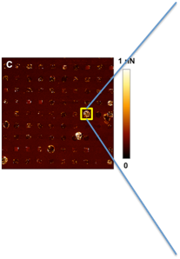
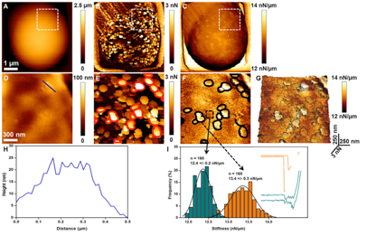
In vitro biomechanical sensing
Mechanical forces exerted by immune cells when migrating inside confining environments
Large scale and high throughput nanomechanical cell characterization using AFM
Cell forces quantified with real time optical analysis of pillar displacement
AFM technique extension from single cell to cell network analysis to ensure sufficient bio statistic
E. Desvignes et al. submitted to NanoLetters 2018
Formosa et al. Nat. Protoc. 2015
Notes:
Force sensors are also developed. In this example deformable polymer micro-pillars are integrated inside confining micro-channels of 6 µm - 12 µm
for detecting and quantifying the mechanical forces exerted by immune cells when migrating inside these confining environments. Through the real time optical analysis of pillar displacement, cell forces are quantified and the role of nucleus in cell nanomechanics revealed in very narrow highly confining channels.

Slide 8
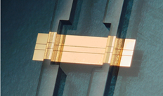
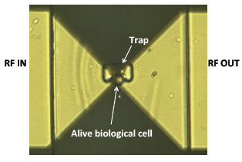
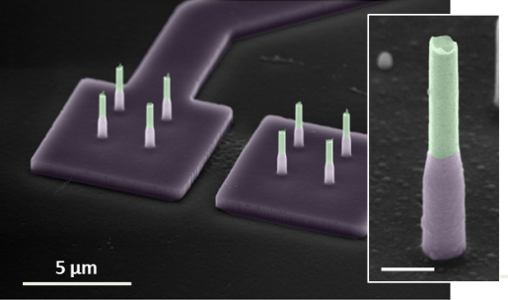
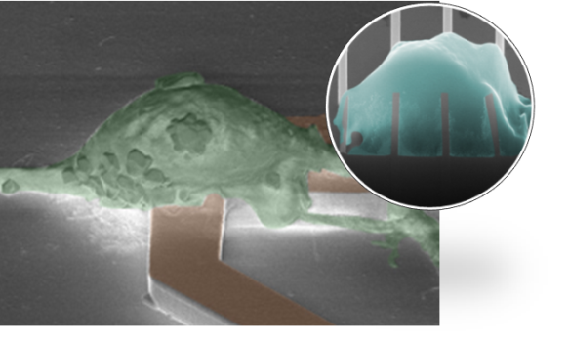
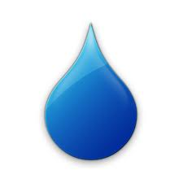
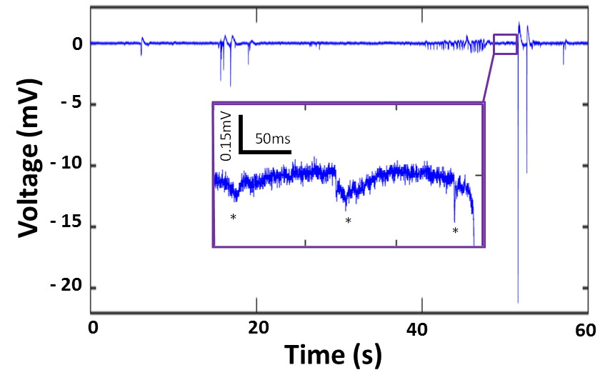
In vitro label-free bioelectrical sensing
Rat neuronal activity recorded by nano-electrodes in liquid environment
Non invasive microwave-based cell sensing/monitoring
From cell suspensions down to single cell analysis in culture medium
Nano-probes
NW inside cell
1mm
RF_{IN}
RF_{OUT}
)))
)))
)))
)))
Casanova et al. IEEE IEDM’17 + patent
1µl
S/N ratio > 2000
Label free cell discrimination of B lymphoma cell sub-populations
Casanova et al. Journal of Physics (2018)
A. Tamra et al, IEEE TMTT 2017 ; K. Grenier et al, IEEE IMS 2018
Notes:
Measurement made after 15 incubation days for electrical maturity on primary cells
Commercial planar electrodes (MEA) : S/N around 10 => 2 decades improvement with NW
3 um height with a 200nm diameter

Slide 9
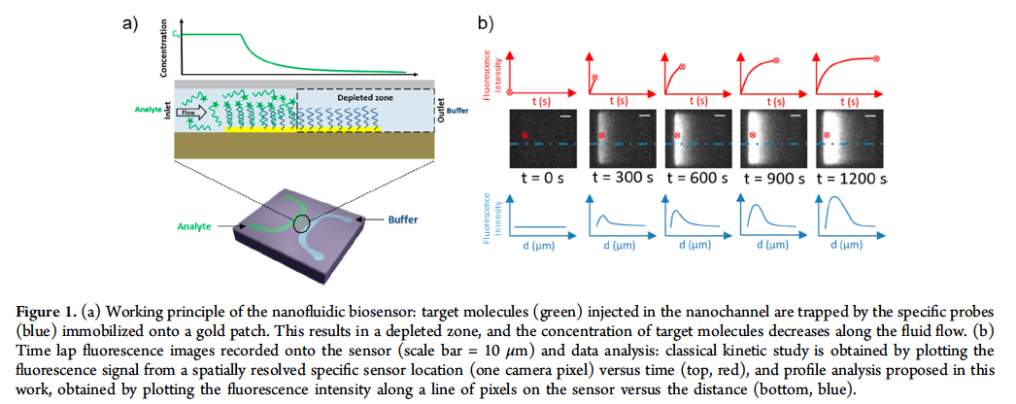
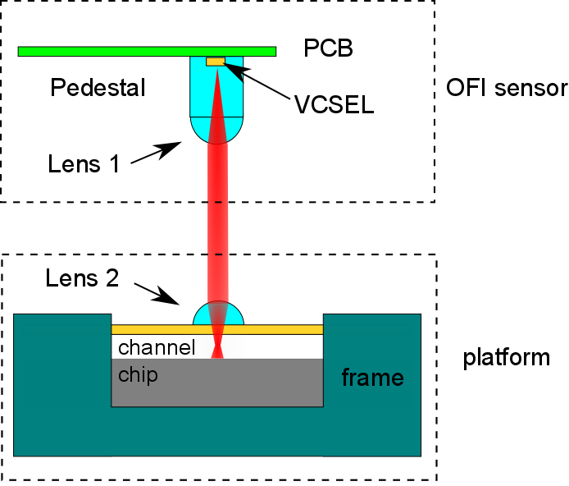
In vitro biophotonic sensing
Single-nucleotide difference discrimination for pancreatic adenocarcinoma diagnostic
Optical feedback interferometry flowmetry sensor in a microfluidic chip with VCSEL and integrated optics
Collimation
<1cm
Selectivity enhanced with nanofluidic confinement
Focusing
Fluid
Miniature and non destructive flow velocity quantification
With integrated lens
J. Cacheux et al. ACS Sensors. 2018
Yu Zhao et al. Opt. Express 2016
Yu Zhao et al. Eurosensors 2017
Notes:
Two examples of in vitro biophotonic sensing , one is a biosensors that takes advantage of nanofluidic confinement to increase the sensor selectivity down to one base pair on a short (20bp) oligonucleotide for cancer application.
requiring a bio-functionalization to obtain the required selectivity in single nucleotide difference discrimination, in a highly challenging cancer problematic , defined sensing is obtained with large optical and expensive lab equipments; whereas the second ex. deals with the miniaturization of an optical sensing technique based on a feedback interferometry sensor enabling flow velocity quantification in blood for instance, with a high degree of miniaturization due to the suppression of the macro-optics, and therefore low cost
Results as good as with macro and bulk optics
This study is at the in vitro stage for now
in movement => Dopler effect ; non invasive, label free; auto aligned (source and detector are the same), portable ; non intrusive, fast, accurate (optic) ; simple and robust

Slide 10
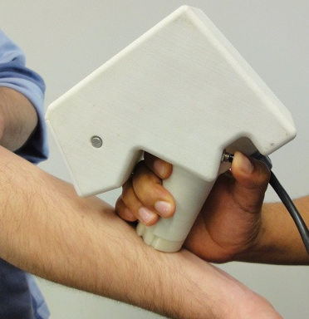
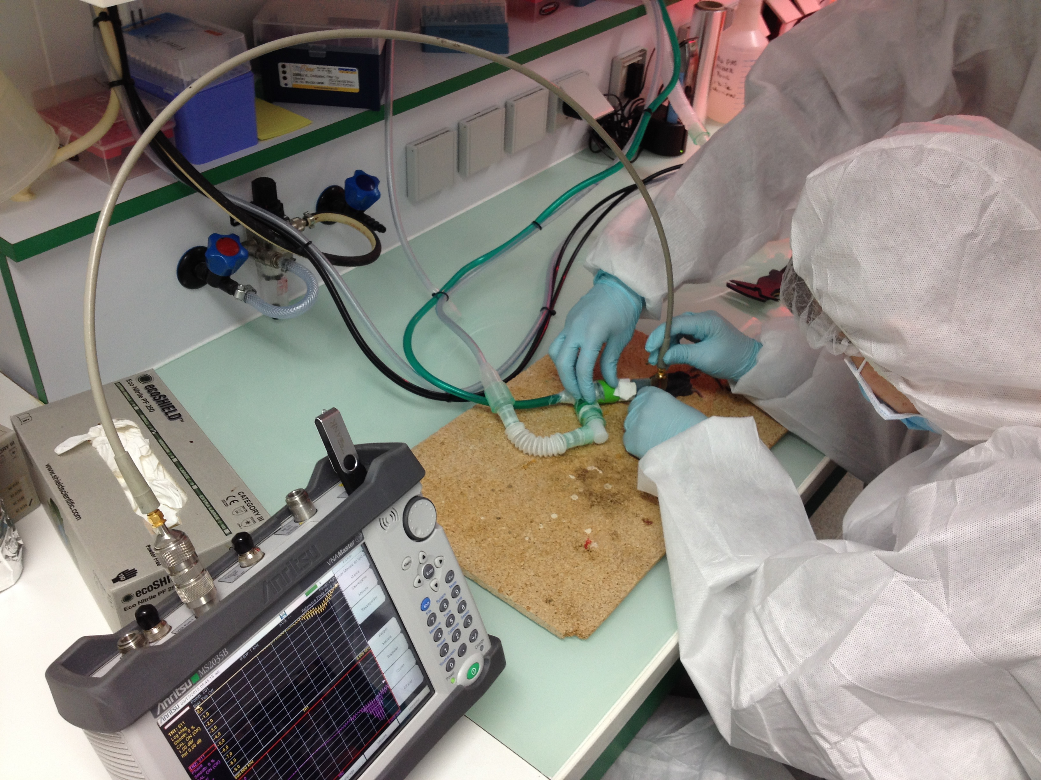
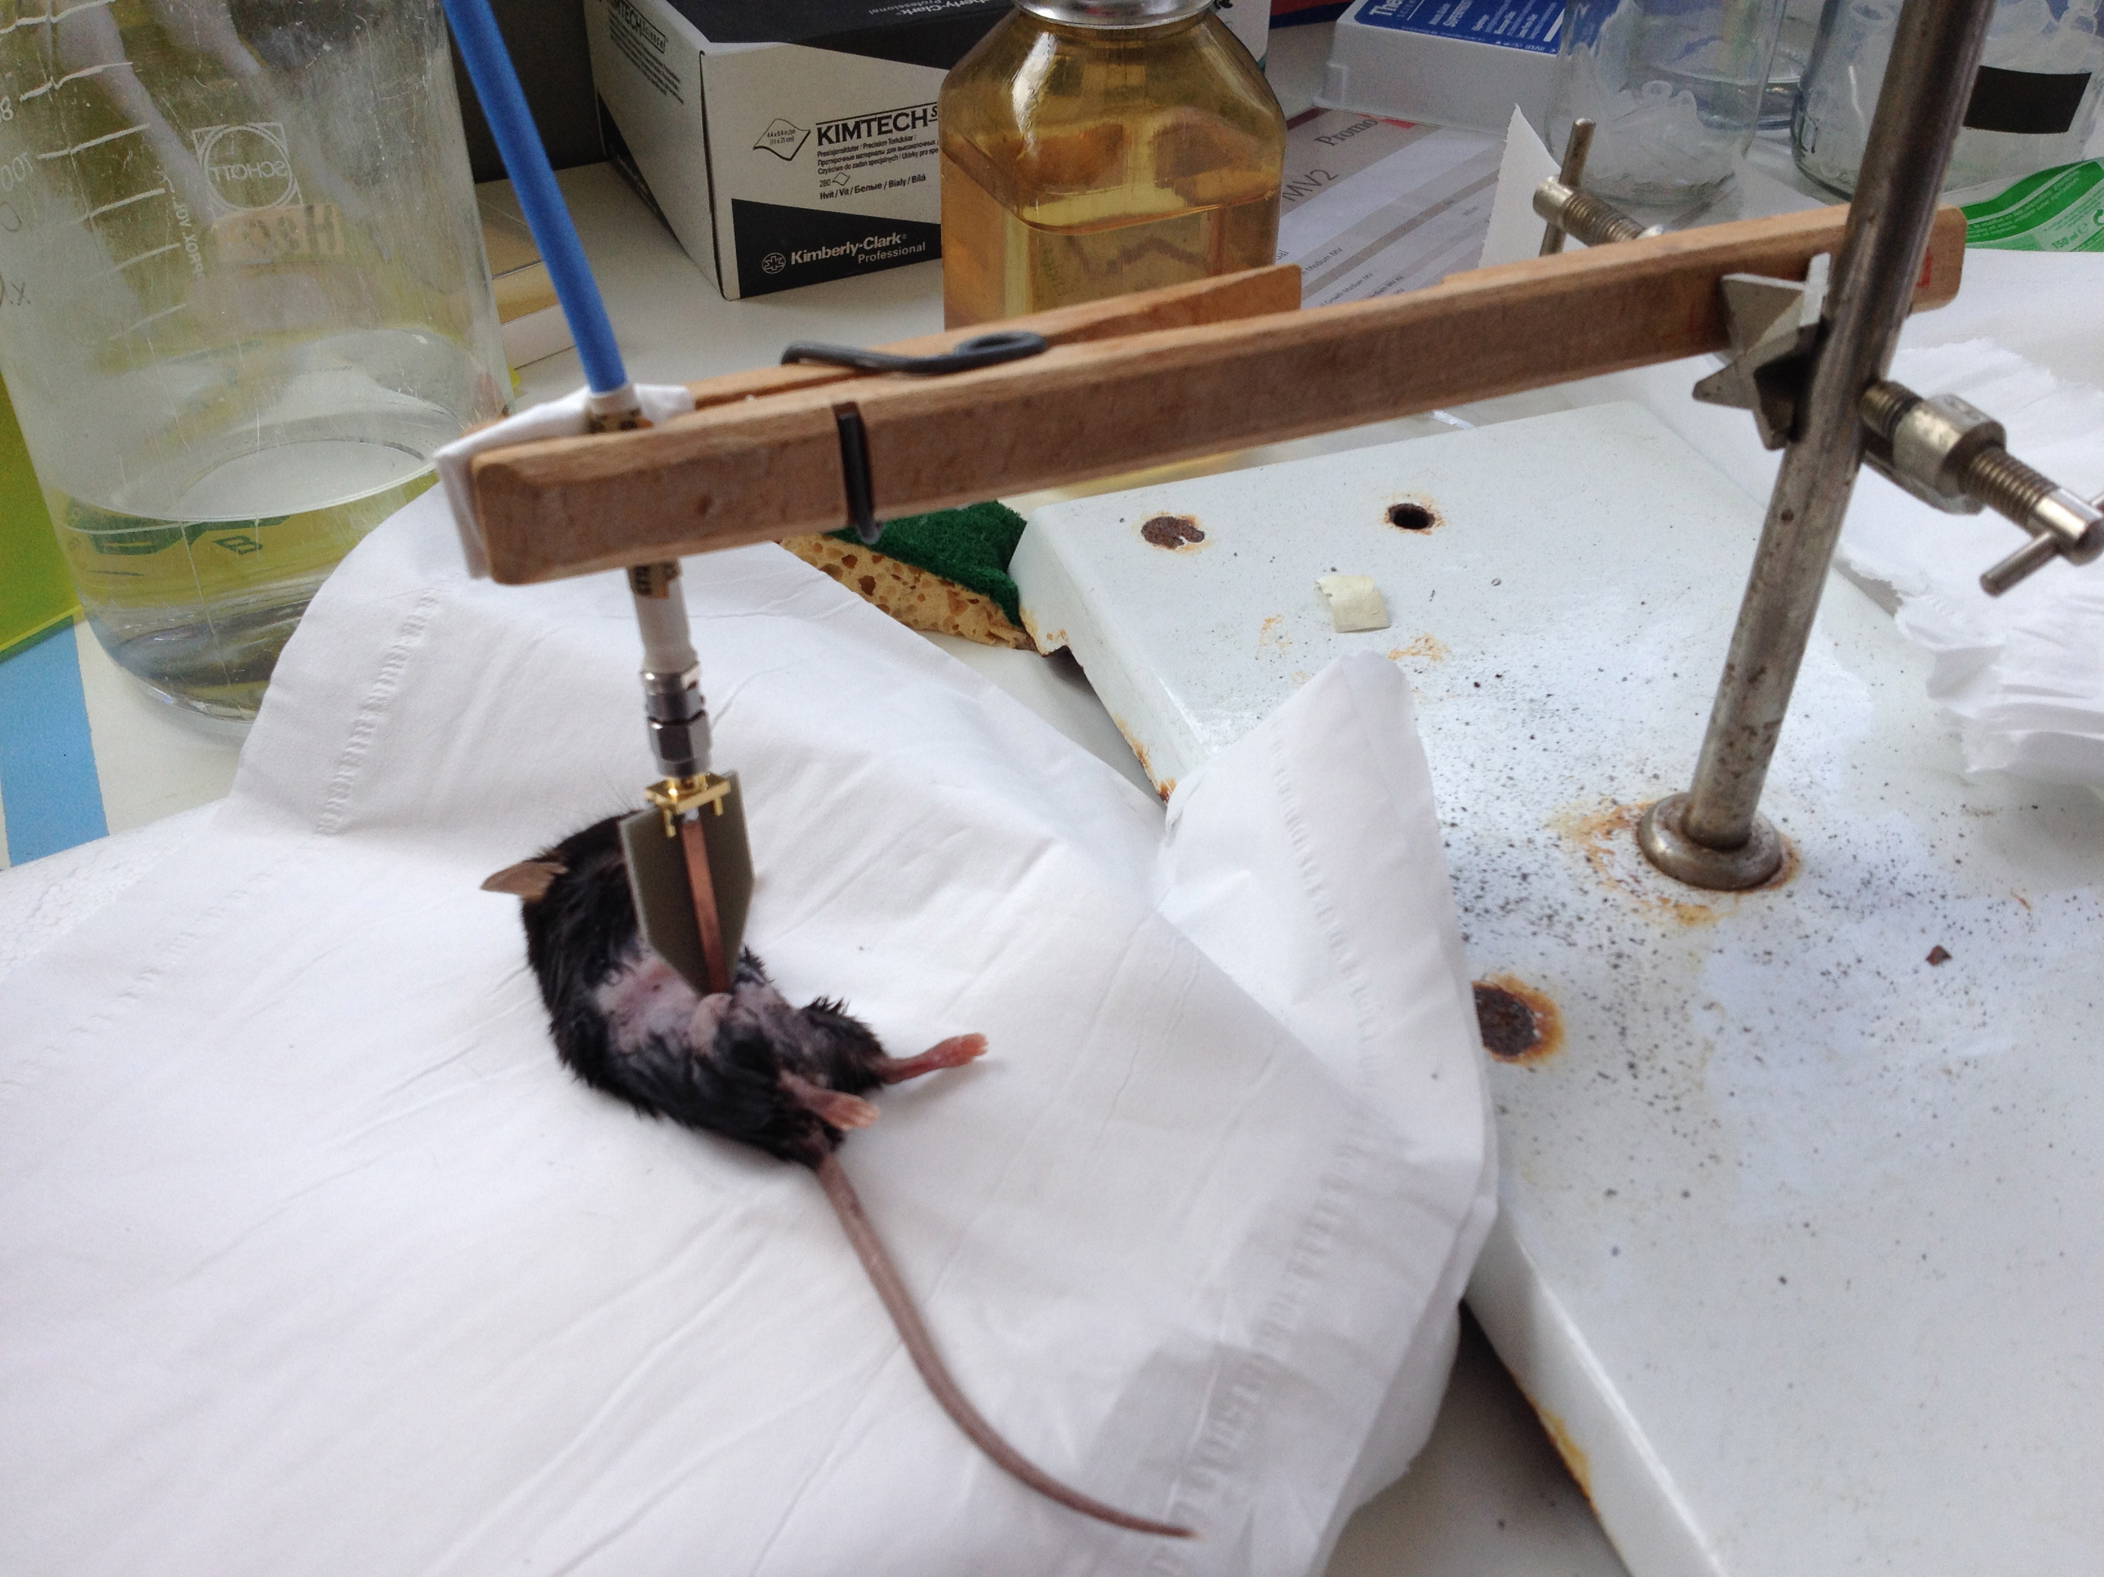
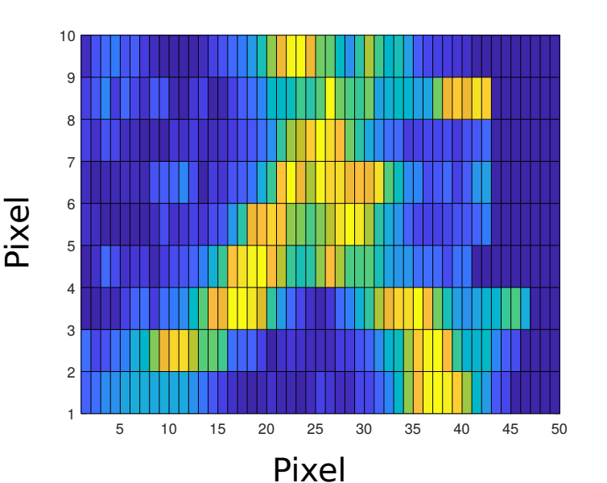
In vivo sensing
Subcutaneous Y shape vein blood flow image recorded by an Optical Feeback Interferometry system
Non invasive skin microwave sensing
- Early detection of melanoma
- Impact of ≠ treatments on lymphoedema
Penetration depth of several mm to cm
Absorption* (dB)
Healthy skin
Vein image
Melanoma
Phase of the reflection coefficient (°)
K. Grenier et al, IEEE IMBioC 2017
B Susini Garmy et al. ATVB 2018
Perchoux et al. Sensor (2016)
Notes:
Whereas with larger optical equipment, blood flow image has already been obtained successively. So previous work could lead to such an equipment of only 1cm square.
Strong resolution.
Further penetration depth with microwave sensing
Still dealing with non invasive in vivo analysis, microwave sensing may also be applied for skin investigations, early melanoma detection for instance or also evaluation different treatment for patients presenting lymphoedema, due to large variation of water content of the tissues.

Slide 11
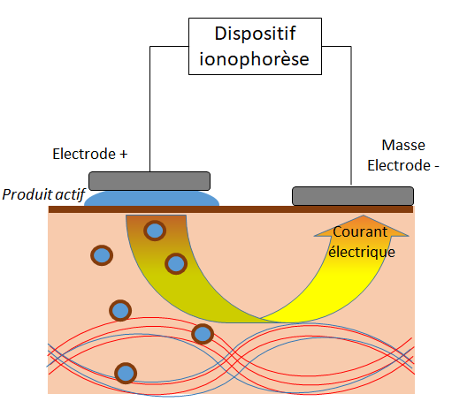
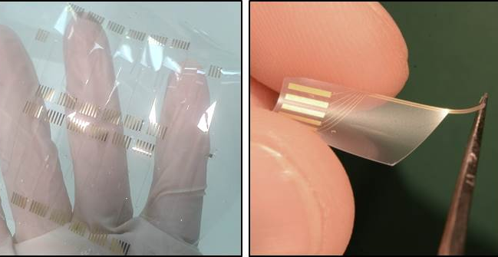
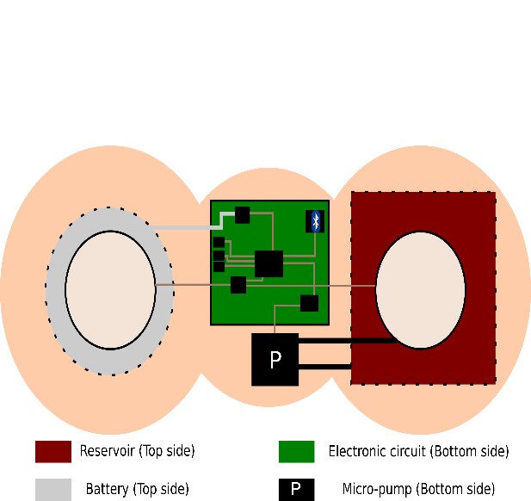
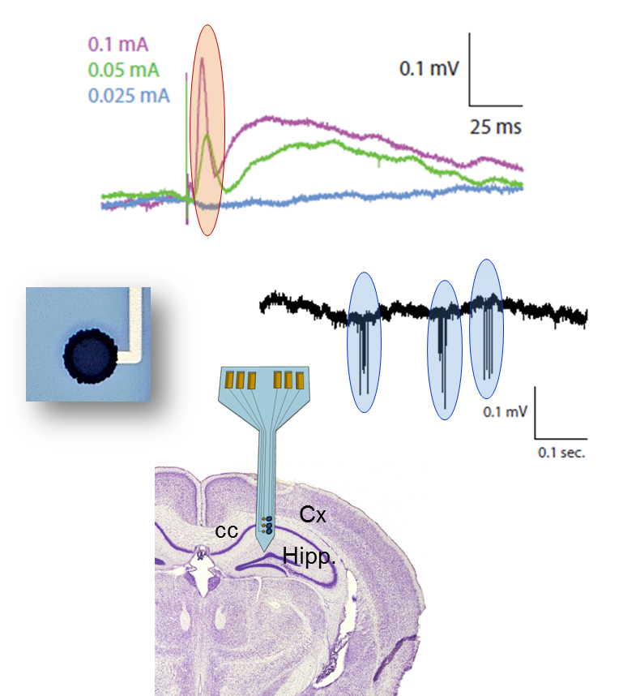
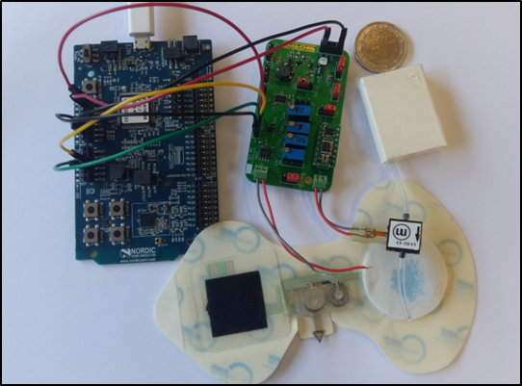
In vivo sensing
Intelligent transdermic patch using a ionophoresis technique
Soft Neural Probes for brain recording
Implantable neural prosthetics device
Accelerated diffusion
- Efficiency
- Biocompatibility
- Stability
of the implanted electrodes
V. Castagnola et al. Biosensors and Bioelectronics 2015
Notes:
Work also on implants

Slide 12
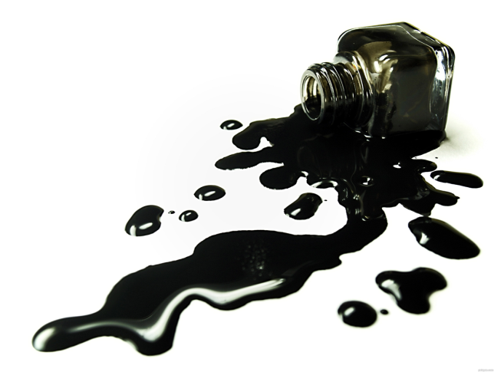

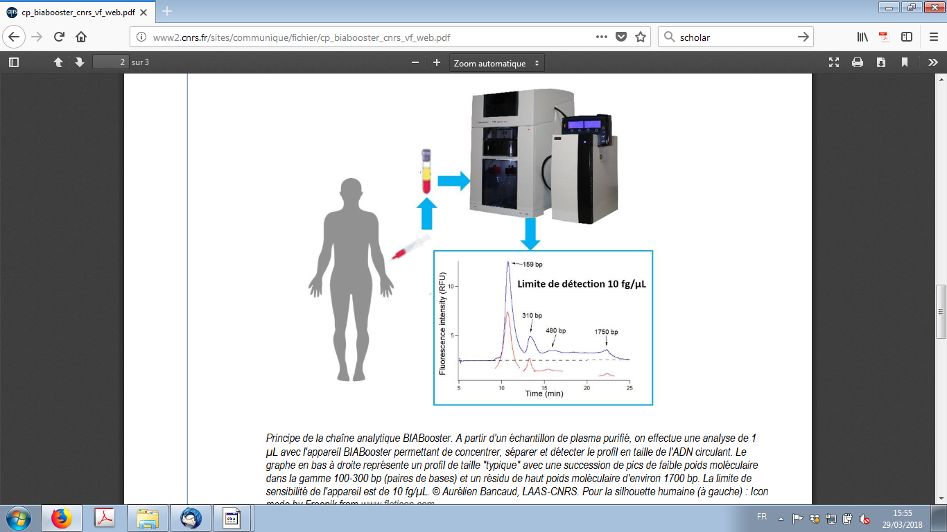
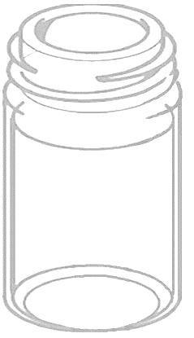
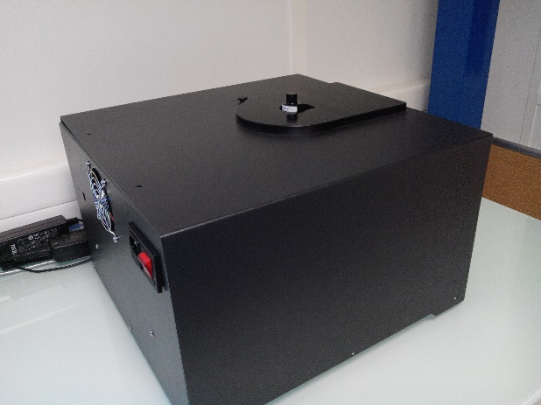
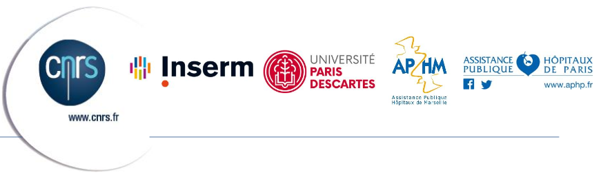
Industrial transfers examples
DNA biomarker identification through size profiling in blood sampling
Instrumentation for highly concentrated, diffusive and/or absorbing colloidal solutions stability analysis
« RF BLACK »
Waveguide in reflection
Waveguide in transmission
Patented
C=30%wt
Non-invasive and non-destructive monitoring of TiO2 sedimentation
Sensitivity down to 10 fg/µL
5%wt
10%wt
1%wt
Notes:
One you already saw, related to biology with DNA biomarker identification, one related to environment related to the stability of colloidal solutions as they may be found in the bottom of rivers or muds.

Slide 13
Conclusions - Perspectives
Similar shared orientations for the BioMedical and Environment domains
Diagnostic
Monitoring
Controlled/artificial environment
Living comprehension
in vitro and with an intensification of in vivo investigations
involving
in-house sophisticated micro-nanofabricated sensors
and/or integrated complete sensing systems
in accordance with the “System” approach of the LAAS
Taking advantages of the richness of LAAS with artificial intelligence, energy harvesting, wireless sensors networks…
With an intensification toward environment applications
and an extension to other domains : Chemistry, Space, Silver economy

Slide 14
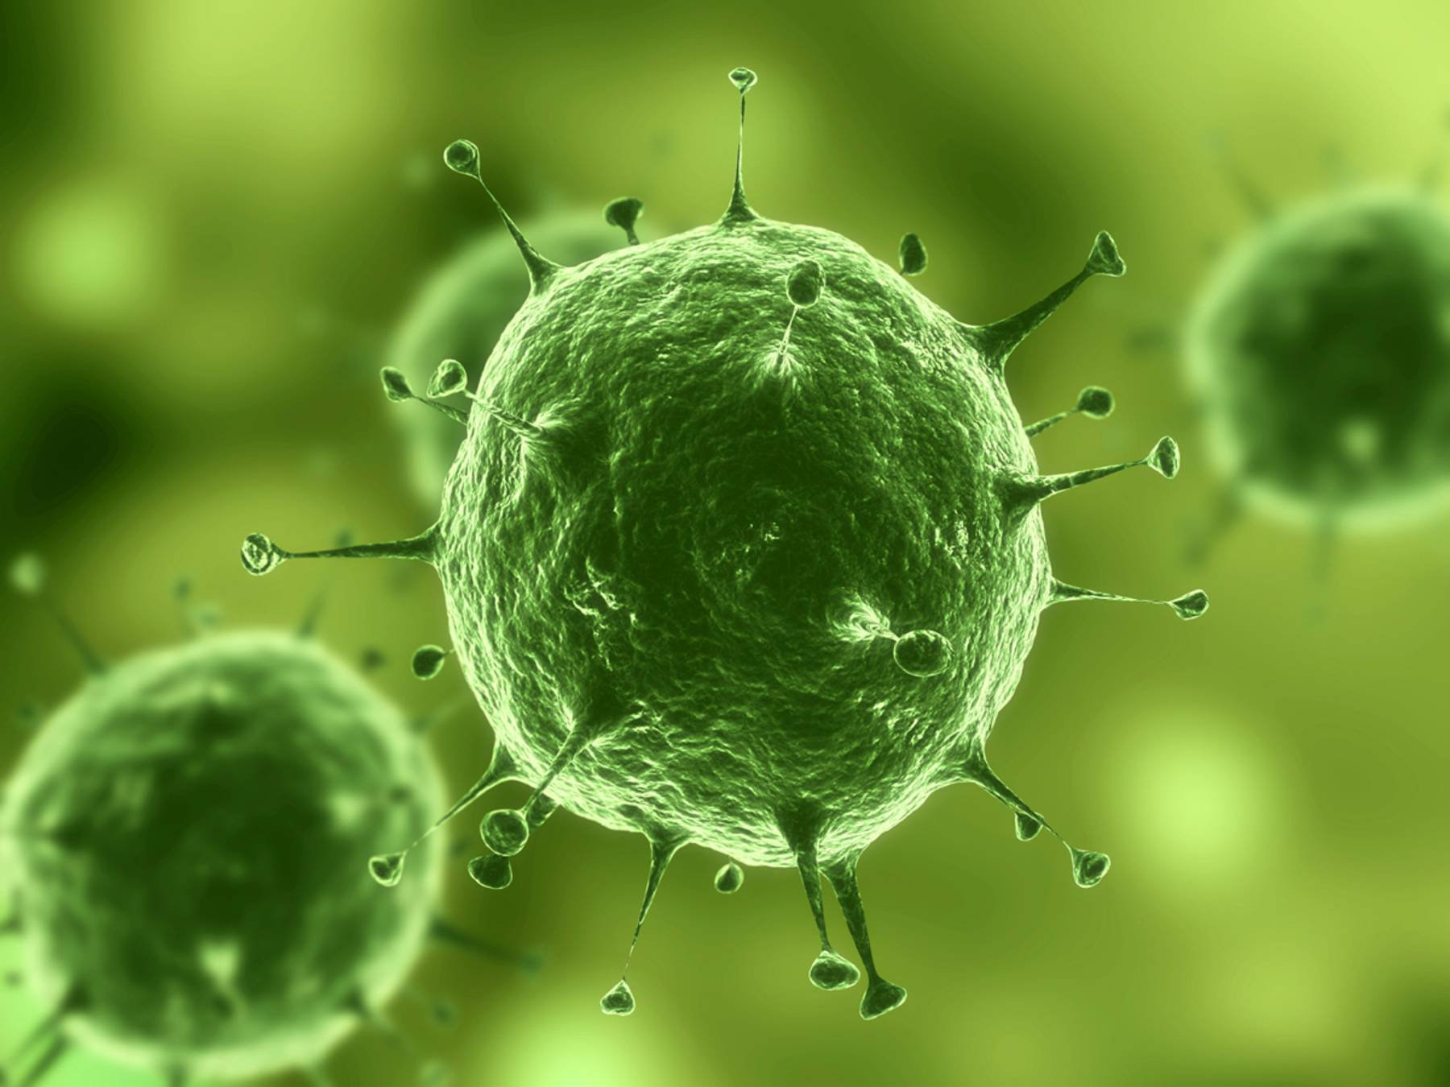
The final words
Living materials
Sensing, analyzing, monitoring the living
Interacting with the living, leading to effects
Using the living as a sensor

