Slide 1
WELCOME TO OUR
1st LAAS Research & Technology Days
LABORATOIRE D’ANALYSE
ET D’ARCHITECTURE DES SYSTÈMES DU CNRS
Liviu NICU
Research Director at CNRS
Notes:
The idea of my presentation is to give a brief overview of the activity of the lab and of the way the lab is interacting with partners on the regional, national and international level.
For this to be efficiently done, you have to first have the keys to understand the French research landscape organization.

Slide 2
My warmest thanks
For everything, to our fantastic ladies
  Anne HEMERYCK
  Marie-Laure PIERUCCI
  Brigitte DUCROCQ
  Anaëlle Contival
  Dominique DAURAT
For permanent support
  Marise BAFLEUR
  Hugues GRANIER
  Laurent BARY
  Laurent BLAIN
  Bruno WATIER
For networking actions
  Jean-Charles FABRE
  Alain CAZARRE
For the day-by-day commitment
  The whole R&T Events Committee
  The whole LAAS Community

Slide 3










LAAS-CNRS identity
CNRS Research Unit:
Engineering Sciences and Informatics Institutes
Convention with 5 founding
members of Université fédérale Toulouse Midi-Pyrénées
Involved in regional or national R&D industrial clusters
Core member of european institutions
Notes:
Briefly, two types of entities hire the people working in the academic area: universities or research organisations.
People from university, Professors, have a mandatory teaching activity; this is not the case for the full-time researchers.
Labs, in France, gather those two populations plus the support personal working in the technical or administrative area.
LAAS is uniquely depending on CNRS but this does not mean that people working in LAAS are only full-time researcher. We have also university professors and associate professors. This makes our force.
Two CNRS institutes fund us: informatics and engineering. We have collaborative conventions with in-town universities.
We have an Affiliate Industrial Club, we are involved in several local and national networks. We are quite pervasive which is pretty time and energy consuming but we have also return on investment signs from time to time.

Slide 4
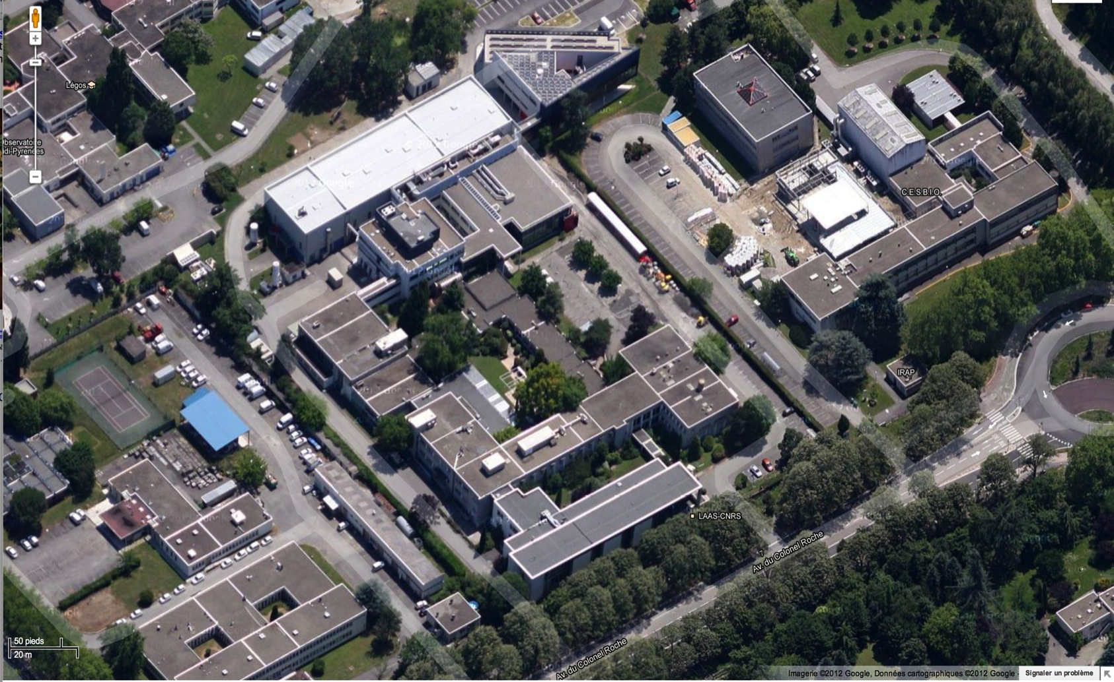
Key figures January the 1st, 2018
≈ 4 Ha
Built surface
≈ 12 000 m²
Offices and experimentations
≈ 22 000 m²
Personnel: 722 (588)
Permanent: 306
• Research: 204
(CNRS: 89; UT: 115)
• Support: 102
(CNRS: 90; UT: 12)
Temporary: 416
• Post-docs : 30
• PhDs: 204
• Contracts : 48
• Hosted*: 134
* Hosted (2017)
- Emeritus : 8
- Affiliate : 9
- Visitors : 32
- Ext. PhDs : 14
- Partnership : 49
- RENATECH : 22
Each year:
• 60+ PhD thesis defended
• 270+ Interns/trainees hosted
Notes:
Several key figures of the lab are reported here:
huge surface,
huge number of people to interact with on a daily base,
huge responsibility.

Slide 5
Core values: what are we standing for?
Context
Evaluation
Realization
Formalization
Need
Imagination
Expression
Creation
Design
Engineering
Notes:
What motivates people in the lab? Is the possibility for everyone to express and exalt her or his potential.
Is the possibility for people to create, innovate and make the impossible possible. Is the ability to address the whole chain of the engineering processes in domains such as ambient intelligence, space, living or energy.
I’ll be back on that in a few minutes.

Slide 6
LAAS spinal cord
4 Strategic Axes – interdisciplinary scientific policy of the lab
8 Departments – scientific disciplines-related units
26 Teams – operational units
10 Services – technical, administrative, infrastructure-related support to research activities
Strategic axes scientific policy of the laboratory
Departments Teams
Services support to research activities
Notes:
The LAAS spinal cord is presented here. 4 strategic axes, 8 departments… (to read on slides).

Slide 7
Strategic Axes
  AMBIENT INTELLIGENCE
        Ambient Open Networked Embedded Systems
        Service Robots
        Critical informatics
  LIVING: Interaction with the living and the environment
    Micro & Nano Systems for biology
    Instrumentation
    3D Bio-impression
  ENERGY: Systems for smart energy management
Energy generation
Management of alternative energy sources
Generic simulation platform for modeling and optimization
  SPACE: From devices to in-flight systems
High performance devices and systems
Embedded systems
Control algorithms for navigation
Notes:
The strategic axes are encompassing most of our activities from an application perspective. Ambient Intelligence is dealing with (etc.).

Slide 8
« It does not make sense » message
It does not make sense to deal with ENERGY topics without Laplace, Cirimat, LISBP, Engie, EDF, Vinci...
It does not make sense to work on AMBIENT INTELLIGENCE without joining our efforts with IRIT, IMT, IRT and all Digital Place and Tompasse members…
It does not make sense to address LIVING issues without CRCT, STROMALab, CBI, I2MC, CPTP, Pierre Fabre…
It does not make sense to explore SPACE challenges without IRAP, CNES, Airbus DS…
And, it does not make sense for all those people to address all these issues without LAAS.
It does not make sense to deal with ENERGY topics without Laplace, Cirimat, LISBP, Engie, EDF, Vinci...
It does not make sense to work on AMBIENT INTELLIGENCE without joining our efforts with IRIT, IMT, IRT and all Digital Place and Tompasse members…
It does not make sense to address LIVING issues without CRCT, STROMALab, CBI, I2MC, CPTP, Pierre Fabre…
It does not make sense to explore SPACE challenges without IRAP, CNES, Airbus DS…
And, it does not make sense for all those people to address all these issues without LAAS.

Slide 9
Departments
Crucial Computing
Tech/Instr° for Monitoring of Complex Systems
Micro Nano Bio Techs
Energy Management
Networks & Comm.
Robotics
Decision and Optimization
Microwaves and Optics
Strategic axes
Dept’s Teams
Services
AMBIENT INTELLIGENCE
ENERGY
SPACE
LIVING
Notes:
The departments are dealing with Crucial Computing challenges, Networks and Communications issues etc.
They are crossed from one part to the other by the four strategic axes that foster common actions involving departments with different disciplinary footprint.

Slide 10
Annual average incomes and outcomes
Incomes:
  Human Factor – 2 new LAAS Community members per day (short or long-term stays)
  Financial Resources – 3 M€/month (salaries included) of which 1 M€/month are EU, national and industrial contracts (10 contracts signed per month)
Outcomes:
  1 highly-ranked journal article per day
  1 PhD defense per week
  “LAAS know-how inside” products on the market
  World-class technological platforms open to academic and industrial requests

Slide 11
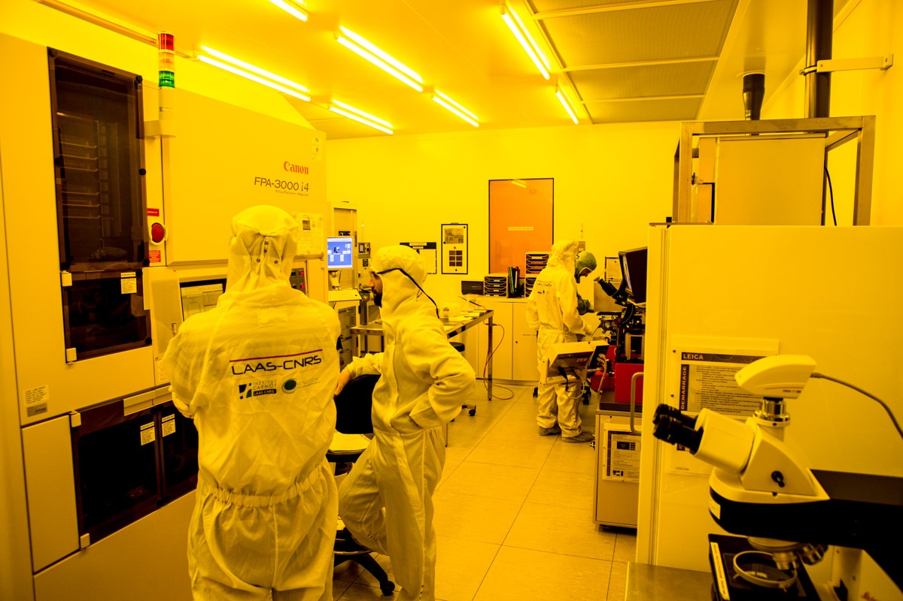
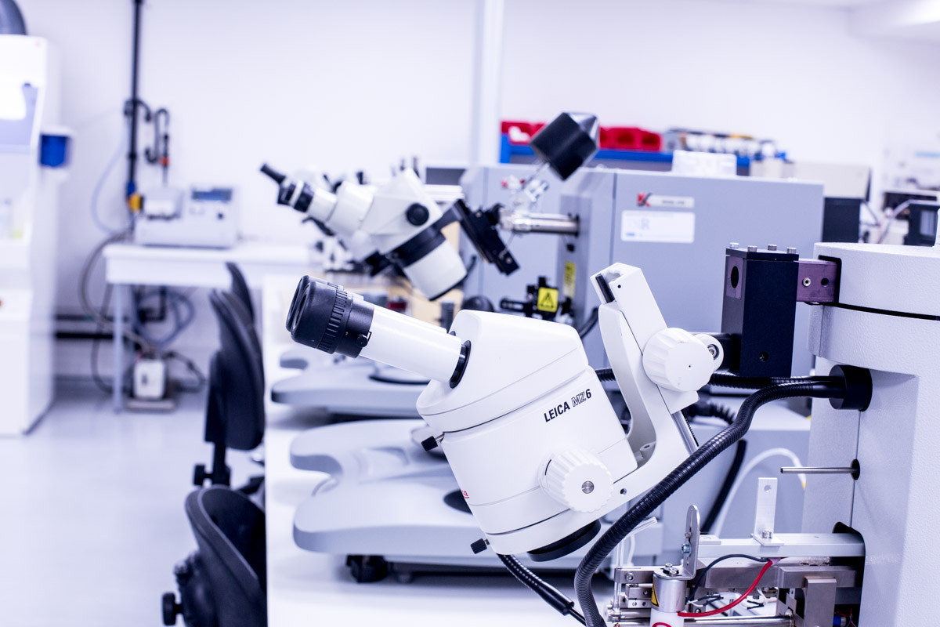
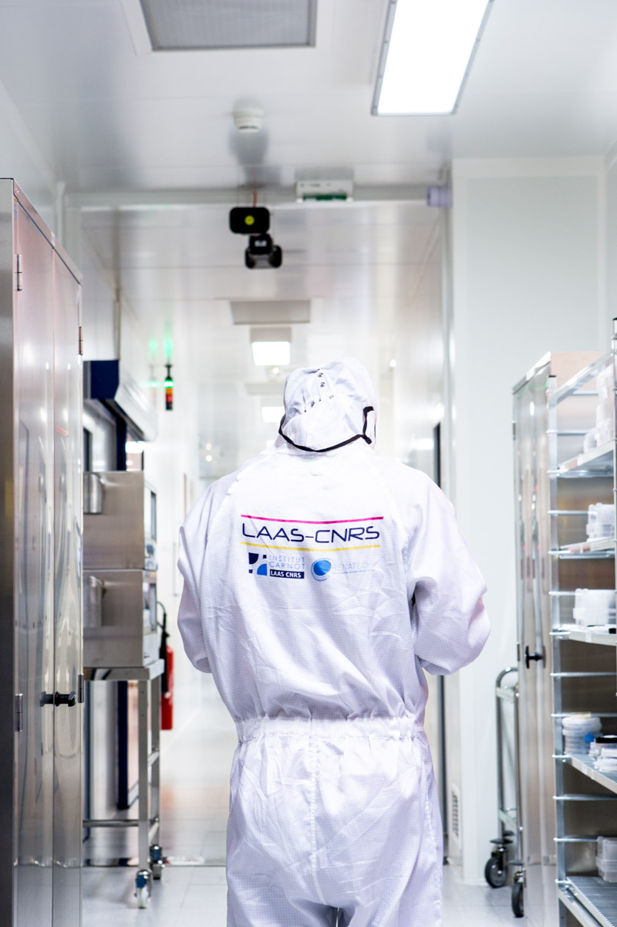
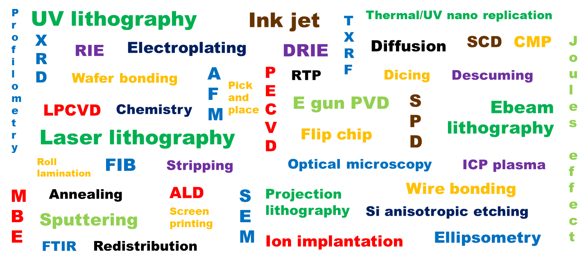
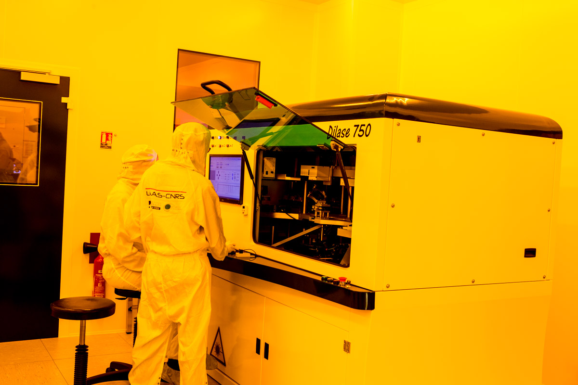

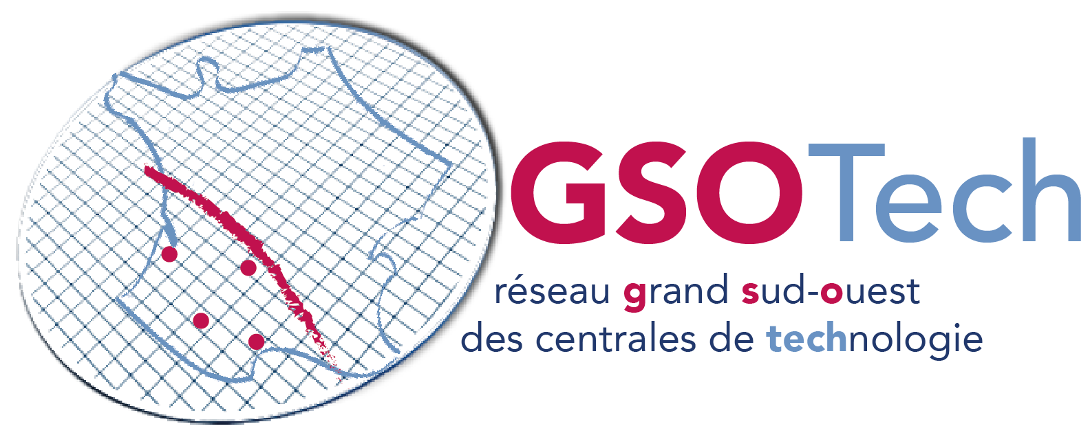
The micro and nanotechnologies platform
An infrastructure/know-how to support micro- and nanotechnology-related projects
  Optics/Photonics
  Micro/Nano-electronics
  Bioelectronics, Biosystems, Biophysics
  Micro/Nano-devices and Systems
The platform
  2500 m² with 1500m² clean room
  180-200 regular users
  140 projects/year (half exogenous)
  1,2M€ operational budget average
  35 M€ equivalent new equipment
TEAM technical staff
  35-40 engineers, technicians
  Expertize, management, maintenance, development of
    Infrastructure
    Equipments
    Processes
  Technological processes
    Direct support
    Formation
    Management
    Dissemination
Member of national and inter-regional networks

Slide 12
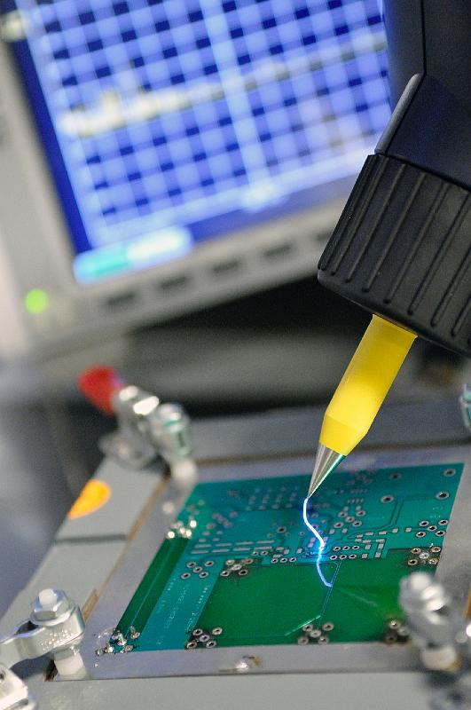
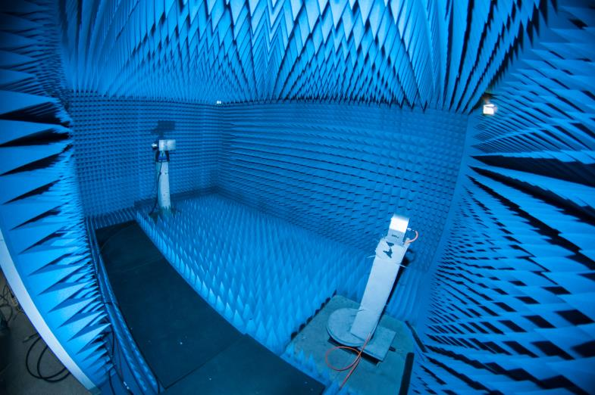
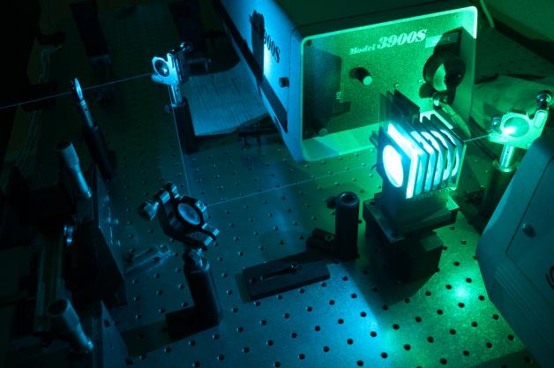
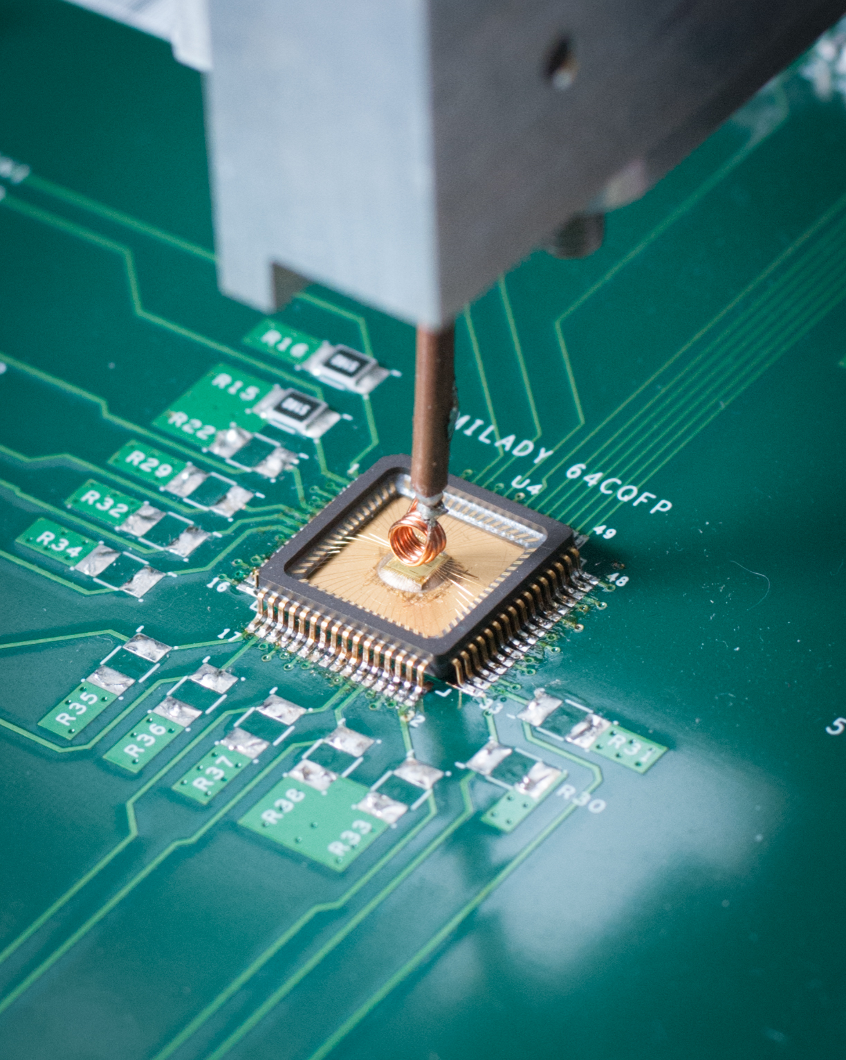
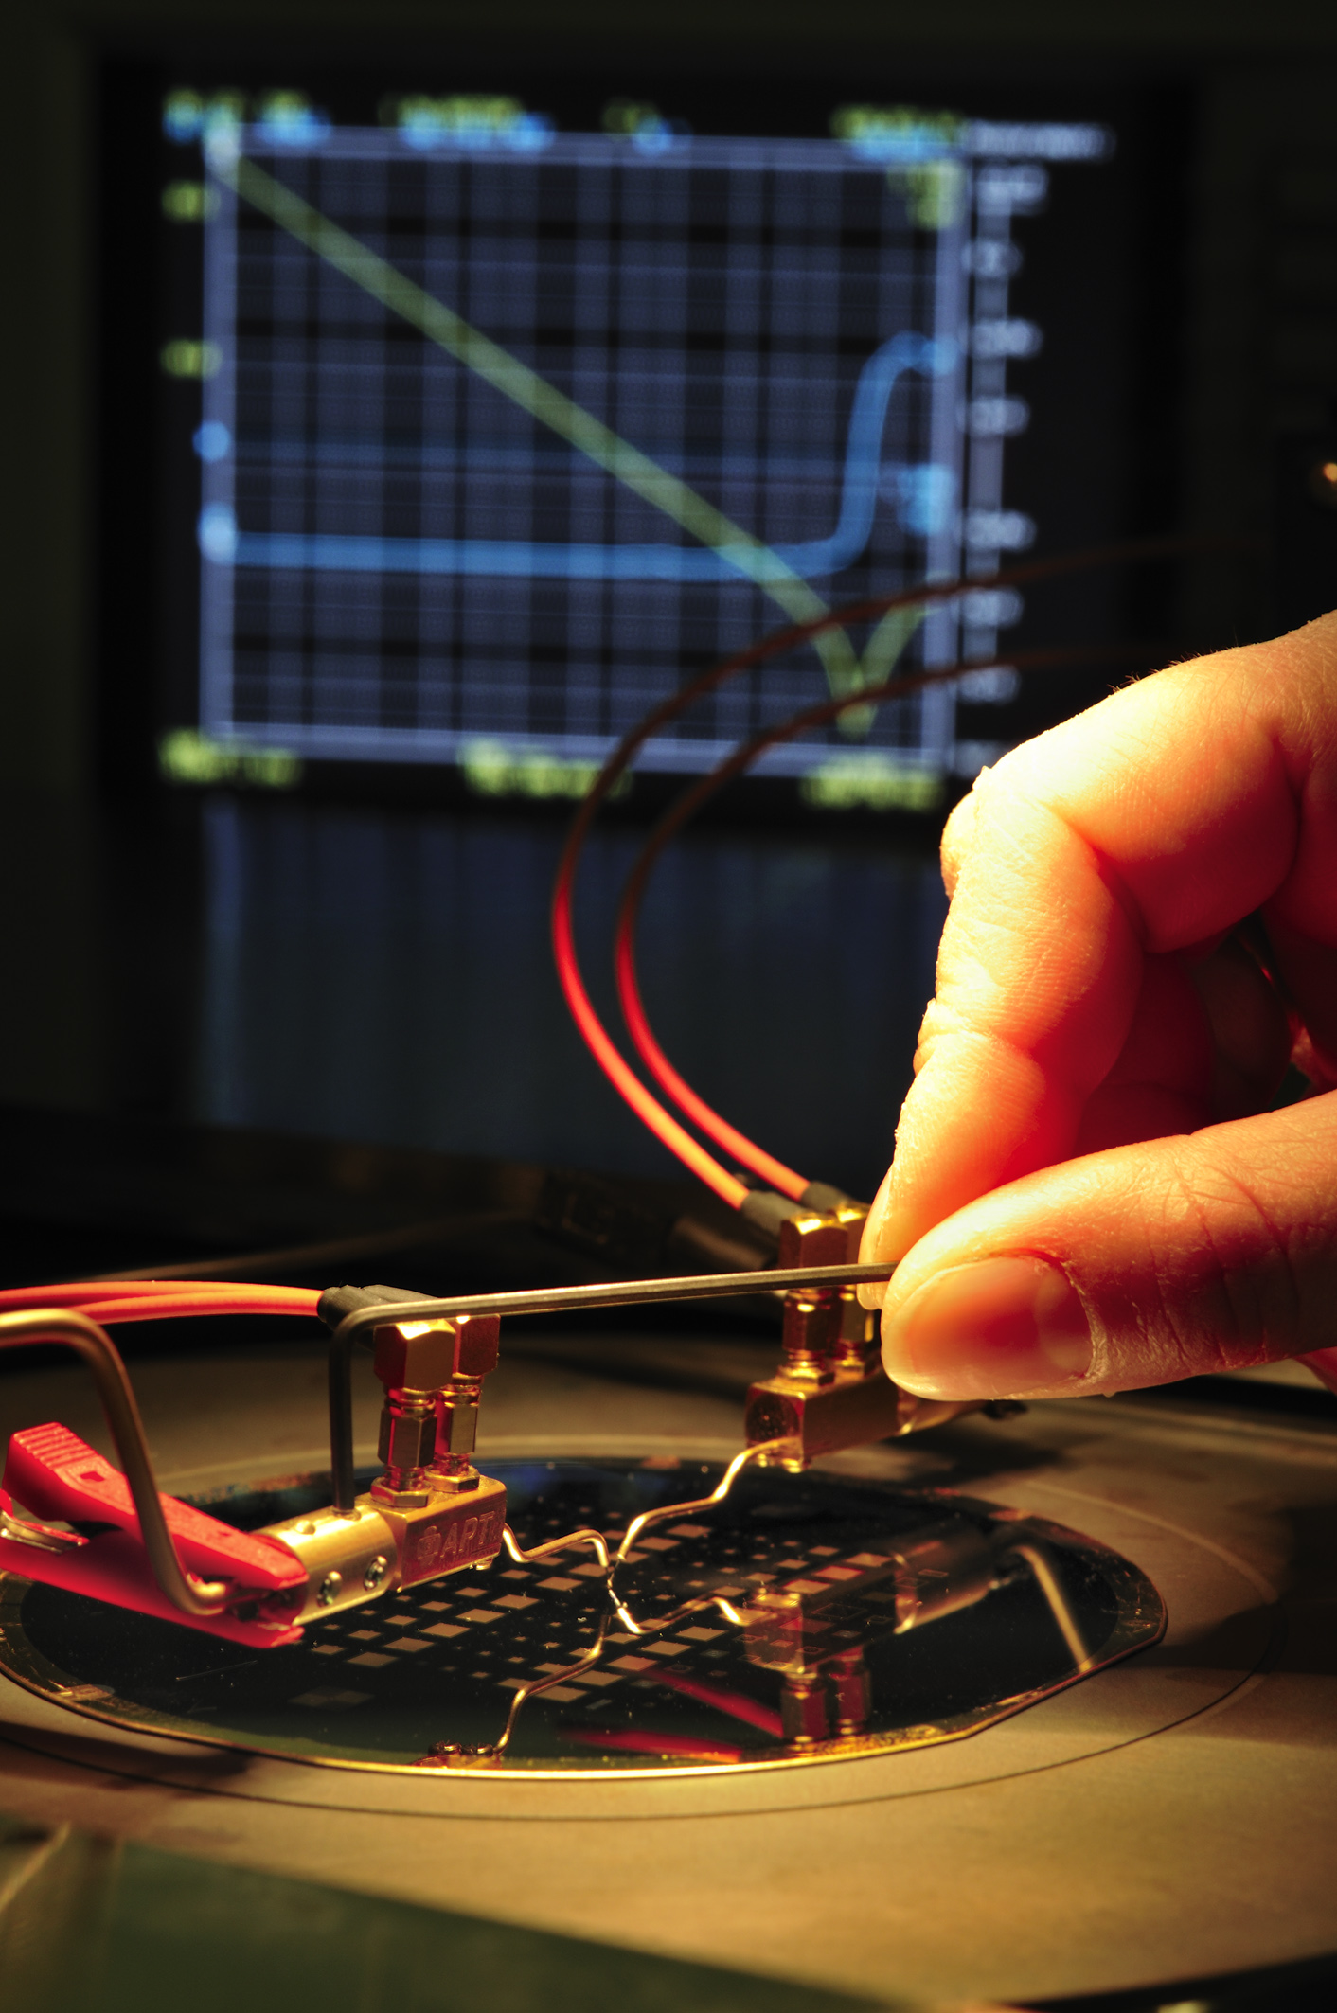
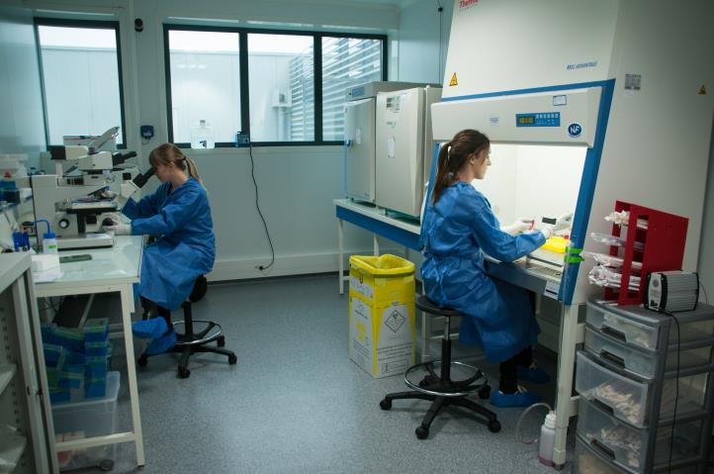
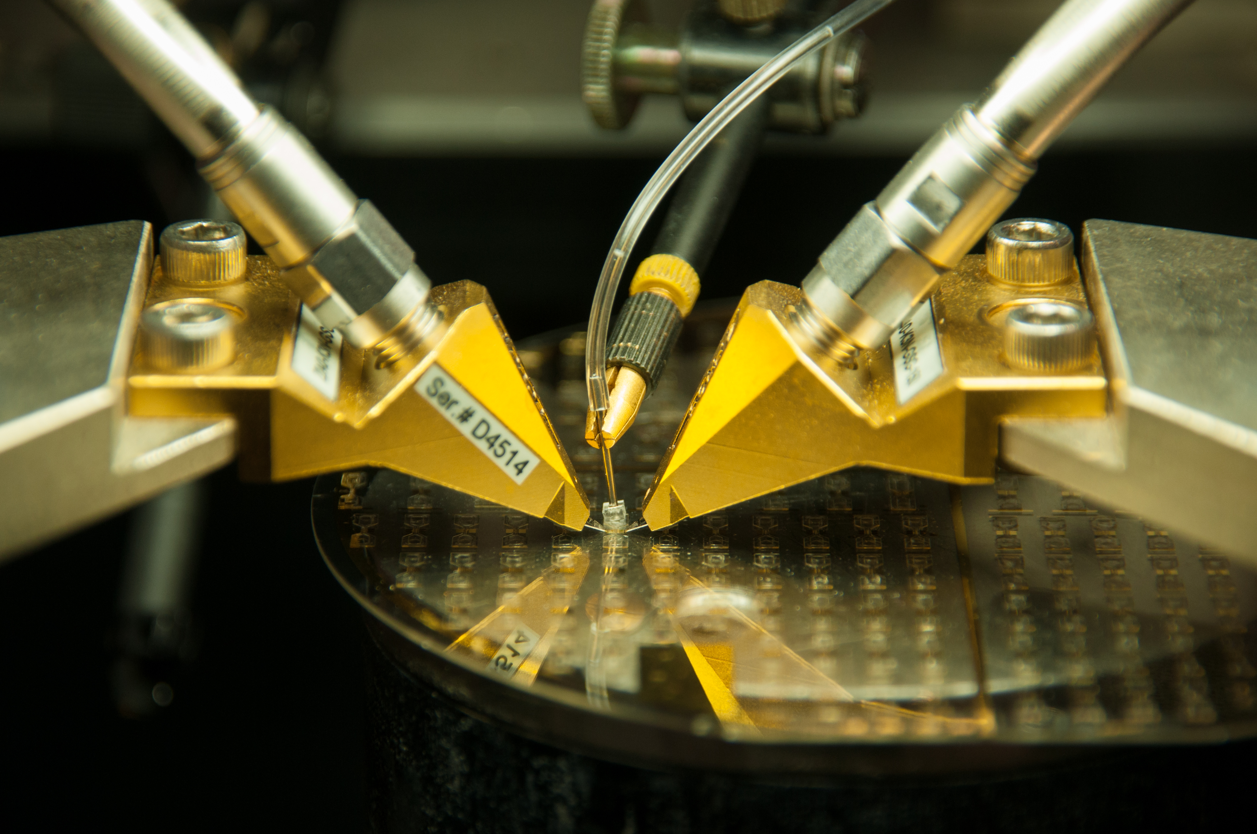
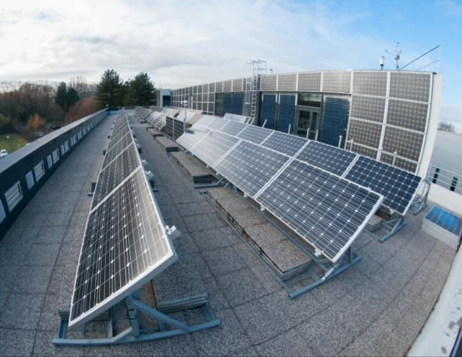
The characterization platform
Platform allowing multidisciplinary characterization:
  biology, microwave, optics, micro and nanosystems, energy management
7 M€ shared equipments over 1200 m² facilities
Open-access platform

Slide 13
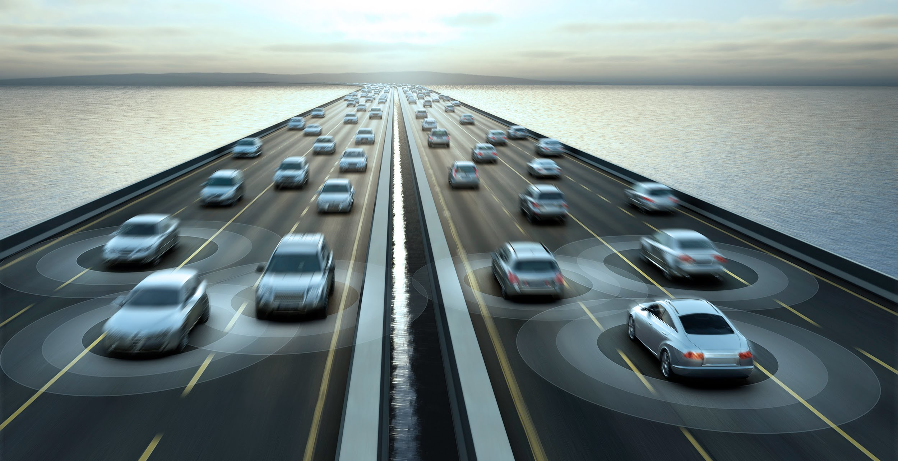
Partnership key figures in 2017
149 opened contracts in 2017
  12 European PRCD projects (2 ERC Advanced Grants), 4 started in 2016.
  Almost 50% involve (at least) one industrial partner
  13 CIFRE conventions started in 2016 [29 actually running]
  3 « LabCom » ANR: BIOSOFT (Innopsys) ; IMPYACT (Lacroix); CapIRO (ACOEM)
  Common Lab with ESSILOR actually running: OPERA (Optique embarquée active)
eHorizon program kick-off (Connected vehicle – CONTINENTAL):
  9 PhD thesis (CNRS)
  12 PhD thesis (CIFRE)
  Global budget (for LAAS): 7,8 M€
Inovation:
  2015 : 13 declarations of invention
  2016 : 26 declarations of invention

Slide 14









Recent Start-ups 2009 ->
EHTech: Energy Harvesting (shower water) — 2009
Epsiline: Laser Technology-based Anemometers — 2009
EXEM: Monitoring Electromagnetism in Radiocommunications — 2010
Seeks: Collaborative Search Engine — 2010
i Habitation: Domotics (building restoration and new) — 2012
3dis Technologies: Cost-effective Circuit Interconnection Technology — 2014
SuBmarine Open Technologies: GPS navigator for diver — 2015
SmartCatch : Intravascular microdevices for the capture of circulating tumor cells in the frame of personalized medicine — 2016
Innorevia : Microfluidic instruments for biomedical analysis— 2016

Slide 15
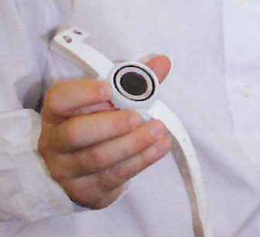
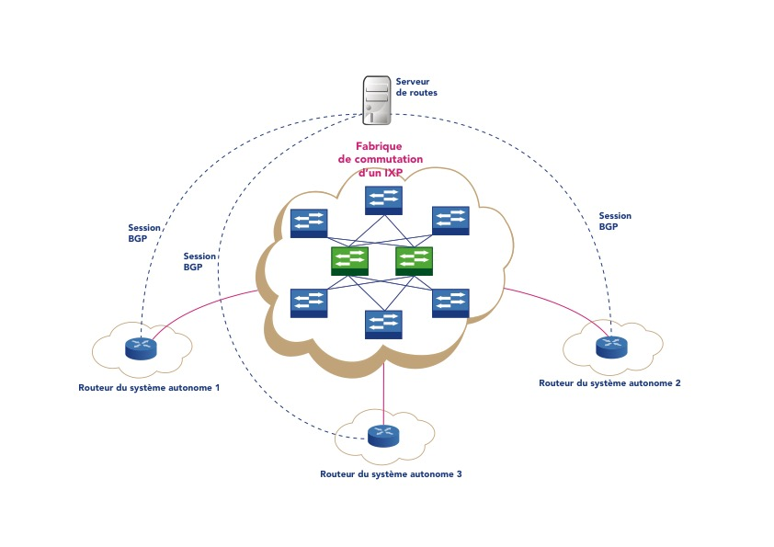
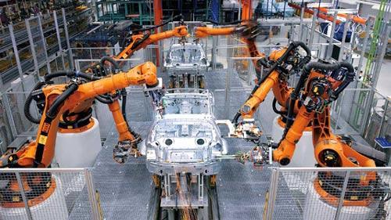
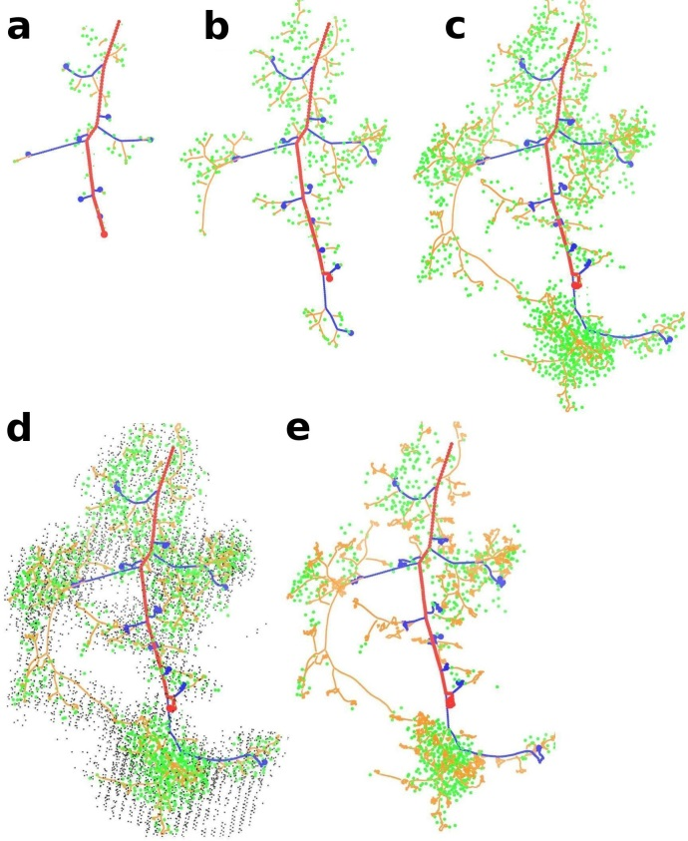
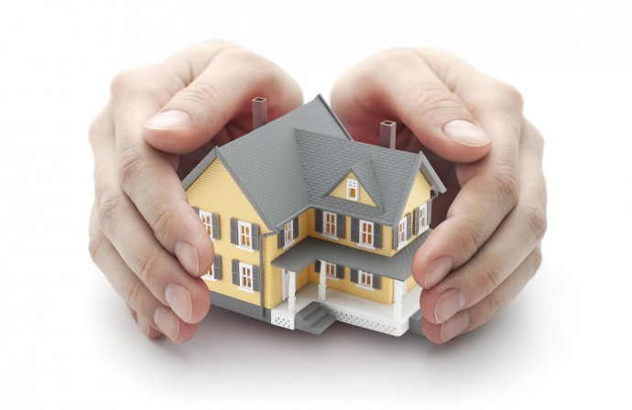
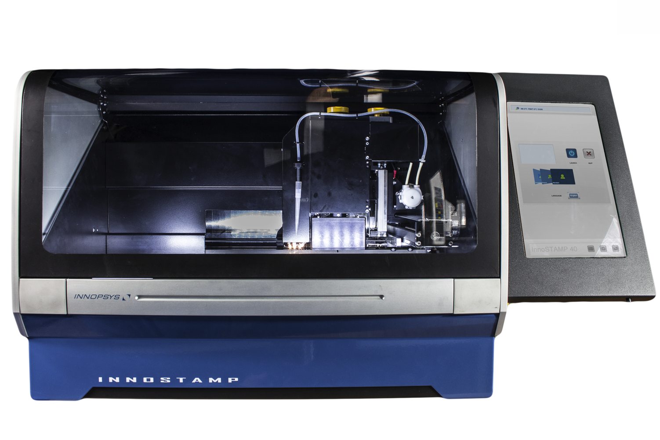
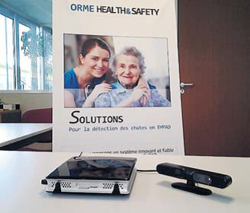
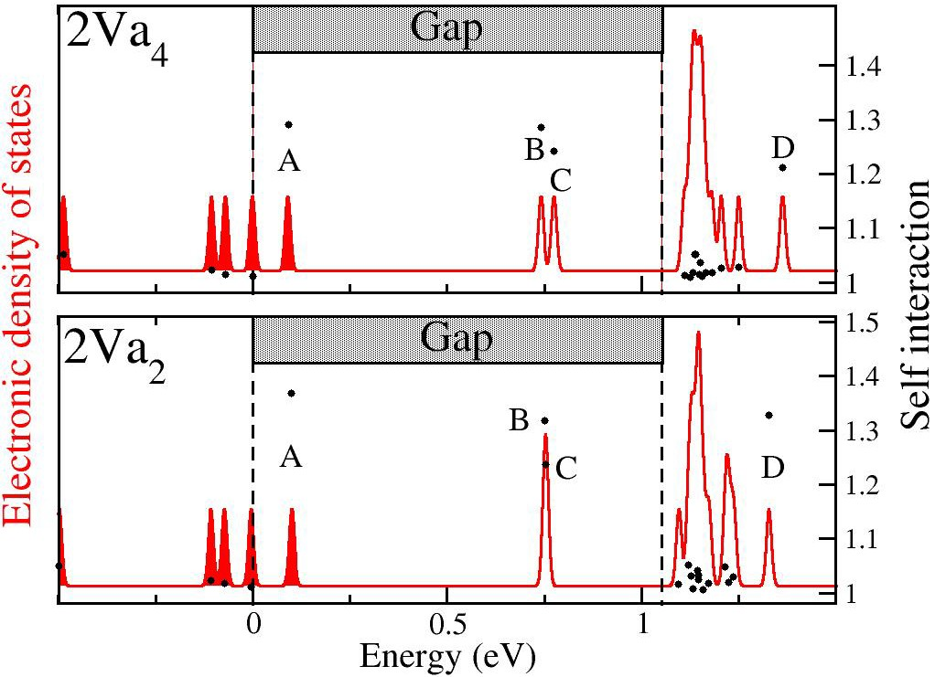
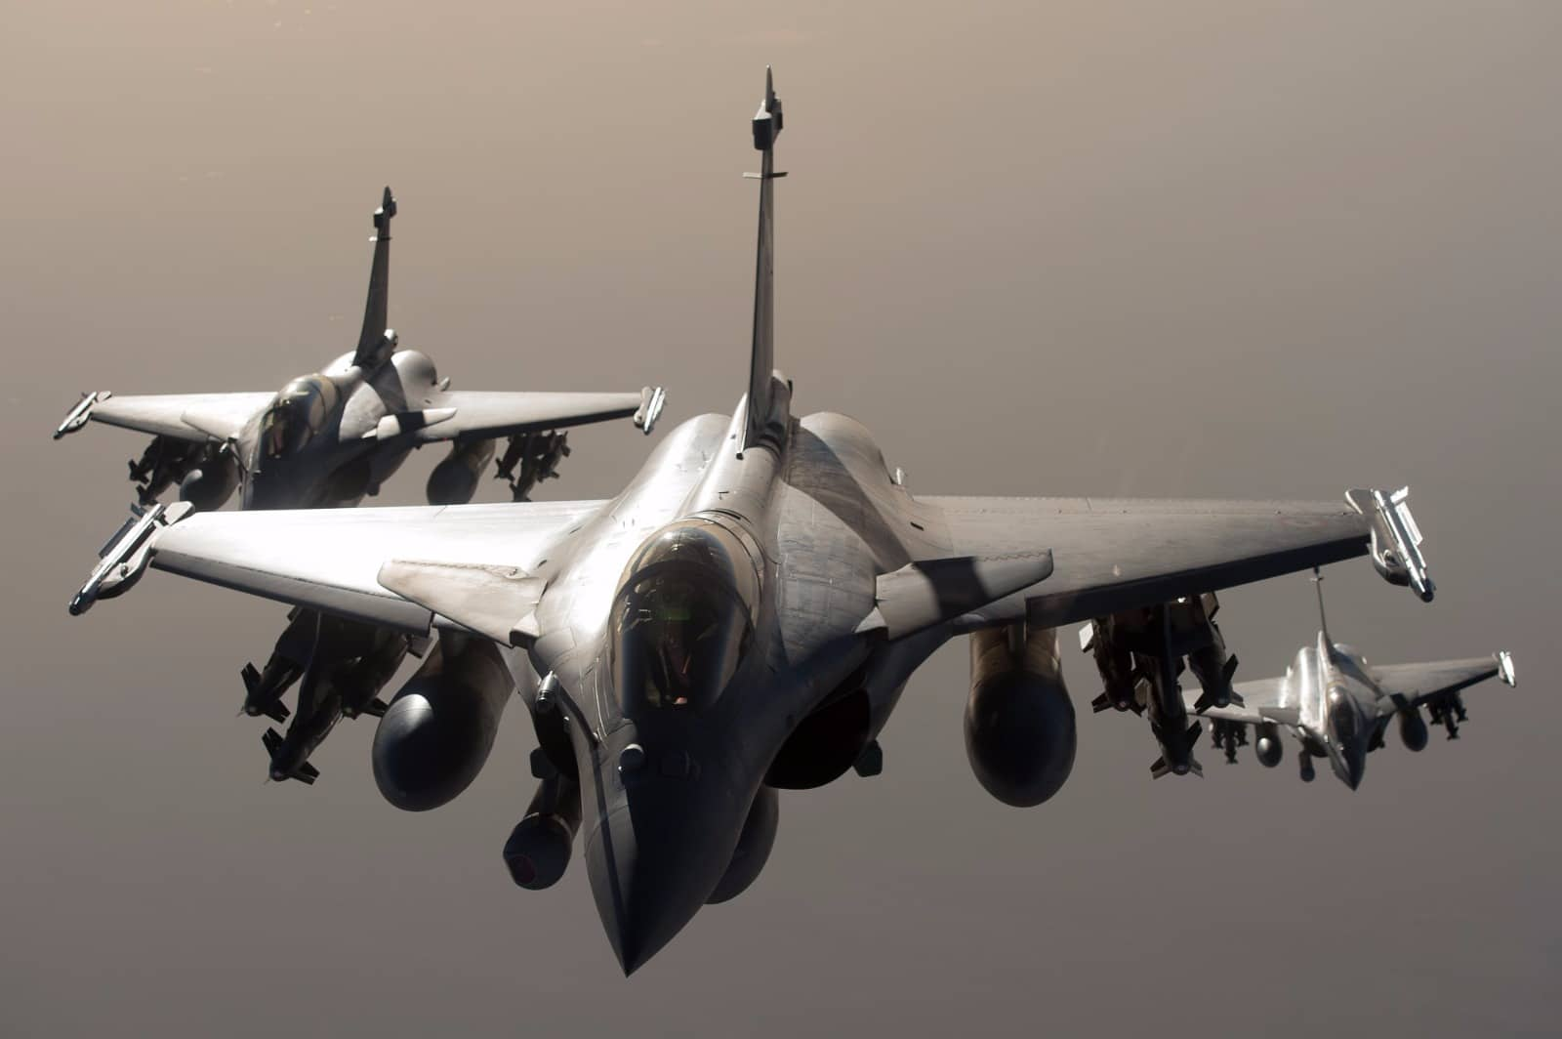
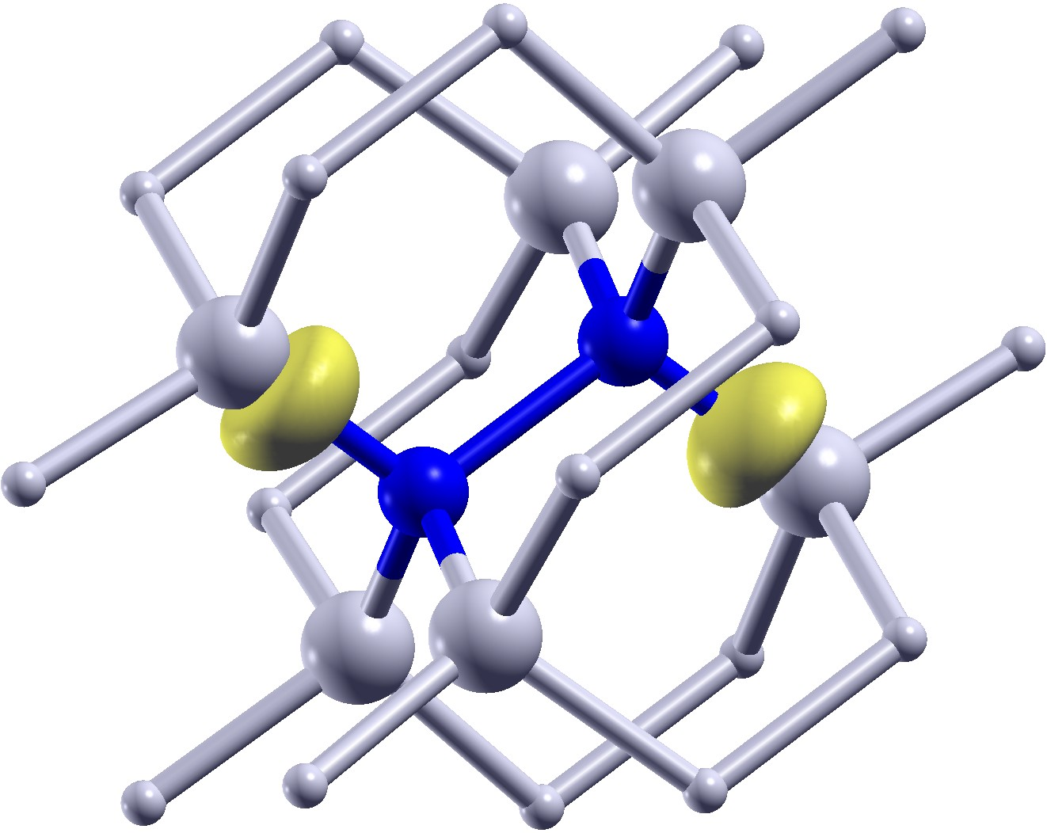
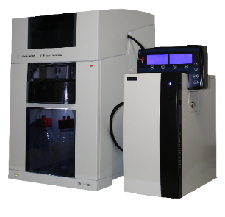
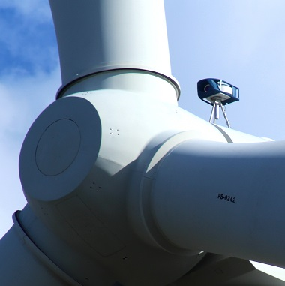
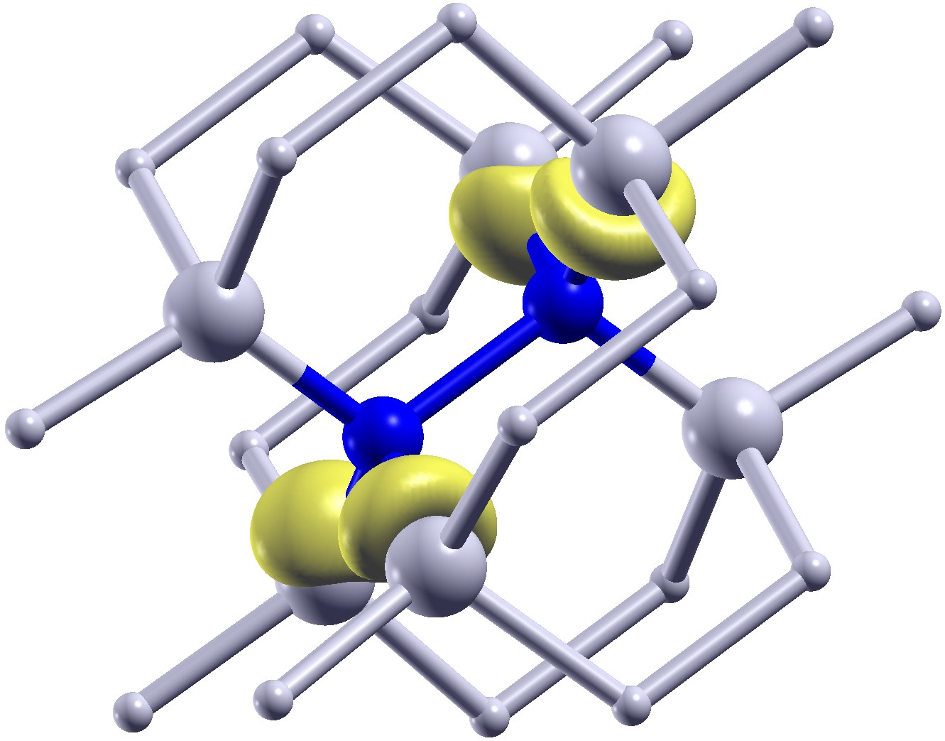
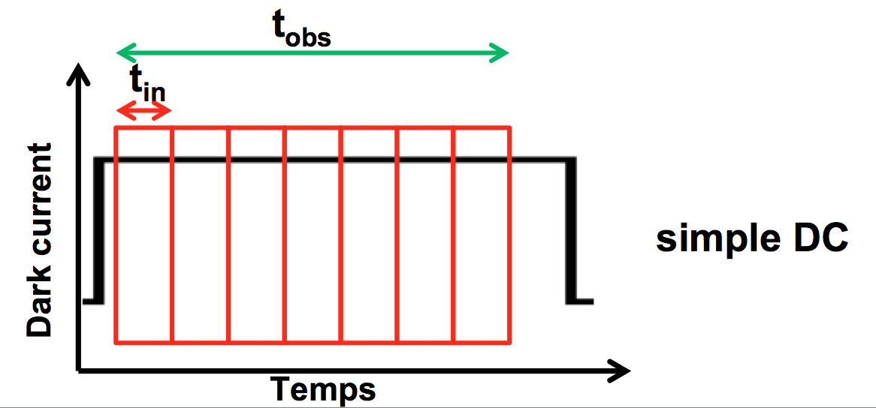

« LAAS know-how inside » label
Process
simulations
&
band gap characterizations
ADVEEZ fall detection algorithms are LAAS know-how inside
To explain signal in photodetectors
Siemens industrial robots are LAAS know-how inside
ST Microelectronics photosensors signal explainability is LAAS know-how inside
Somfy home protection systems are LAAS know-how inside
Innopsys micro-contact printers for medecine are LAAS know-how inside
PicoMetrix on-line processing of DNA technology is LAAS know-how inside
Dassault’s Rafale aircraft gets LAAS know-how inside its active antenna transceiver
TOUSIX software designed technology is LAAS know-how inside
ORME vision sensors for elderly fall monitoring are LAAS know-how inside
EPSILINE lidar-based technology is LAAS know-how inside

Slide 16
What is LAAS inspiring?
People
Faith
Projects
Living in the future
We are the first smiling faces
your newborn future sees
Notes:
What’s LAAS inspiring to me : people that have faith in what they are doing on a daily basis, setting-up projects that will eventually allow living well and raising awareness about what future would be.

Slide 17
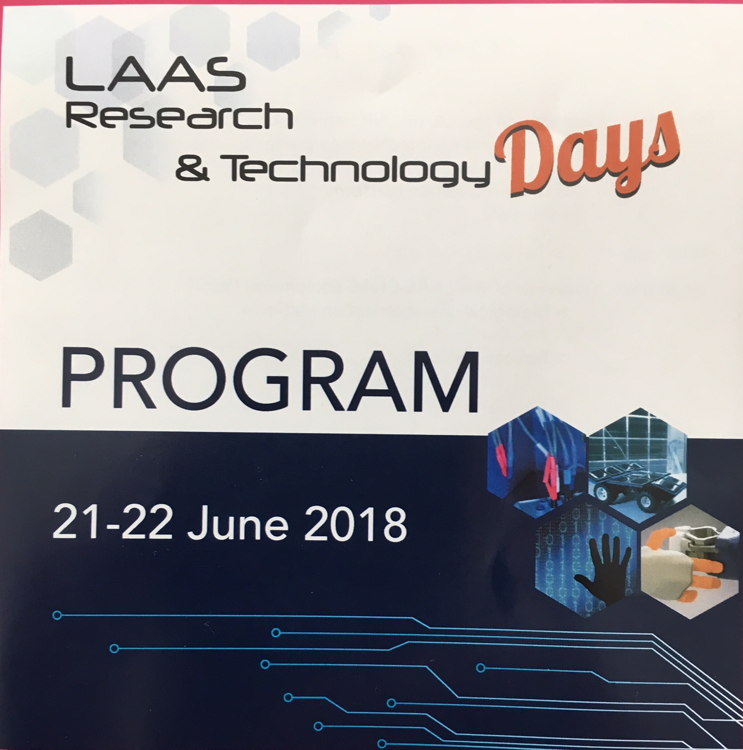
Latest news
2-days event
Parallel sessions
Platforms visits
Experimentations visits
B2B speed dating
… still room to register for the 2nd day events!

Slide 18
Have the most fruitful and nicest event ever among the LAAS Community

Slide 19
Motion generation for nonholonomic systems: from robots to humans

Slide 20
Lessons from Mars and Beyond: The Projects, People, and Culture of the JPL

Slide 21

Concluding remarks
I saw people…
Thank you for having shared this 1st day with us!
Tomorrow morning, rendez-vous at LAAS!
It’s time for questions (if any).
Allez la France!

